Slide 1

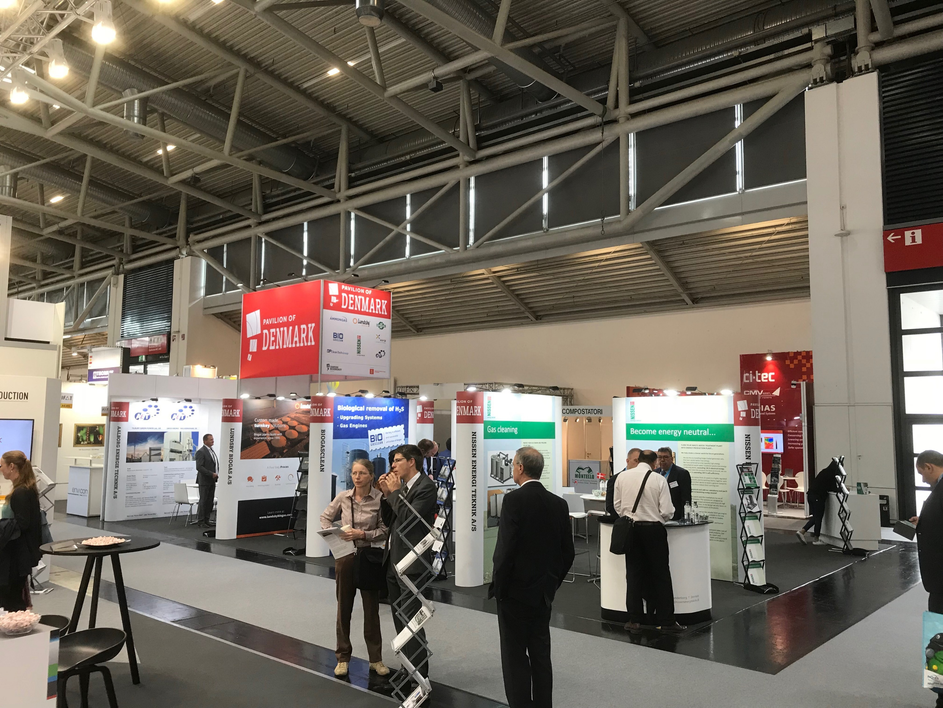

IFAT, MÜNCHEN - GERMANY
30 MAY – 3 JUNE 2022

Slide 2
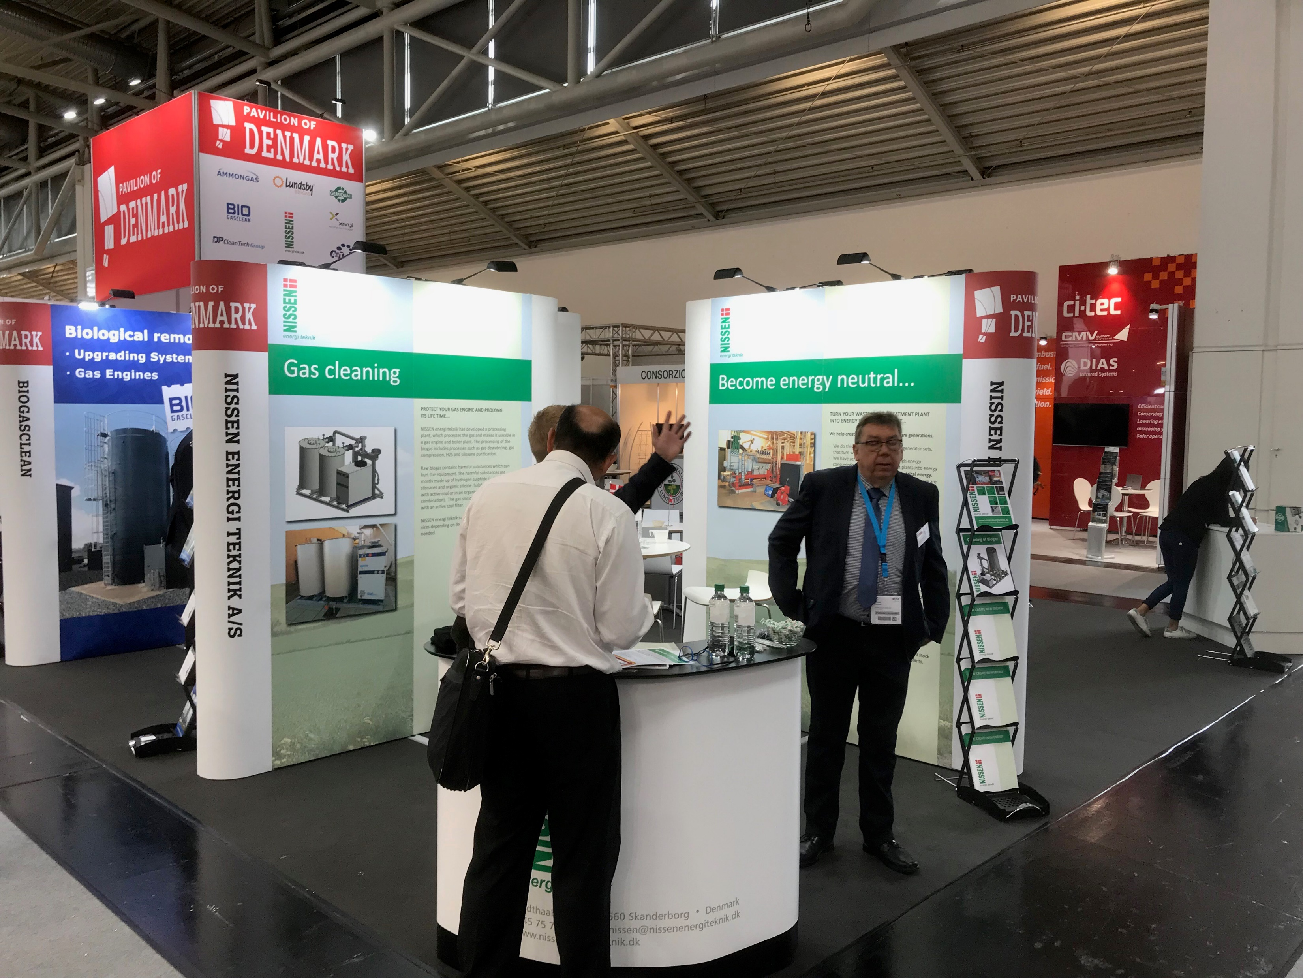
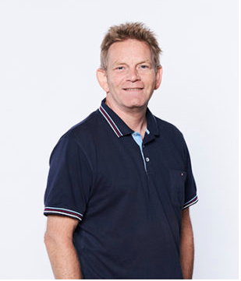

Standesign Contact:
Project Manager:
Torben Munch
E-mail: torben@standesign.dk
Phone: +45 53 56 79 66

Slide 3
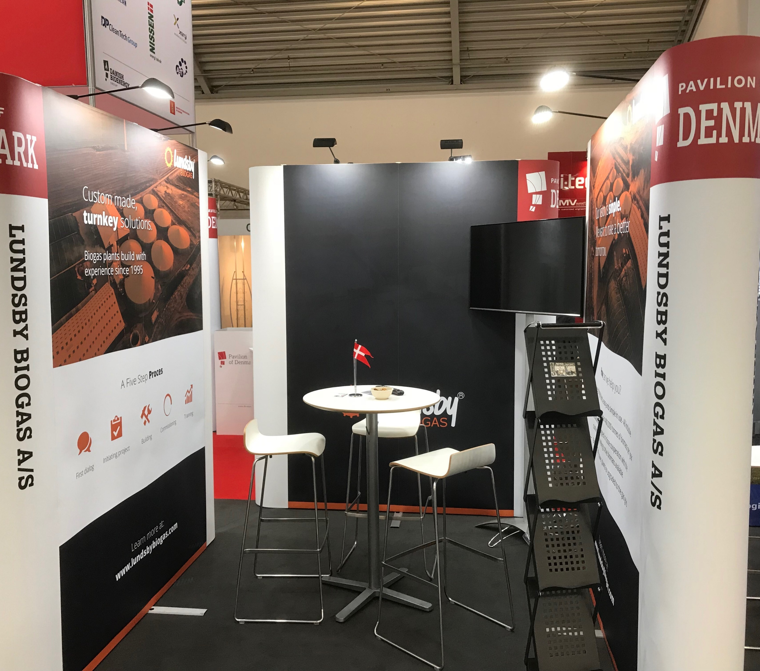
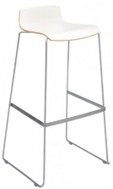
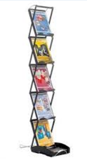
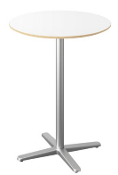
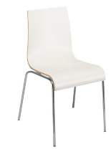
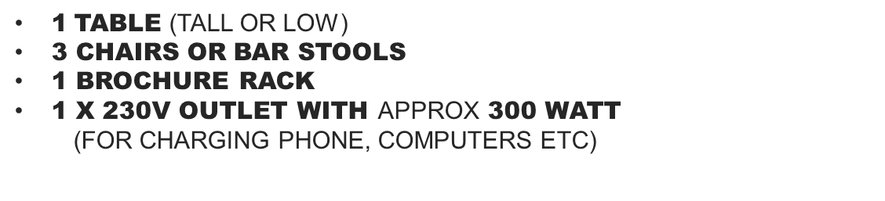
Furniture included in your fee

Slide 4
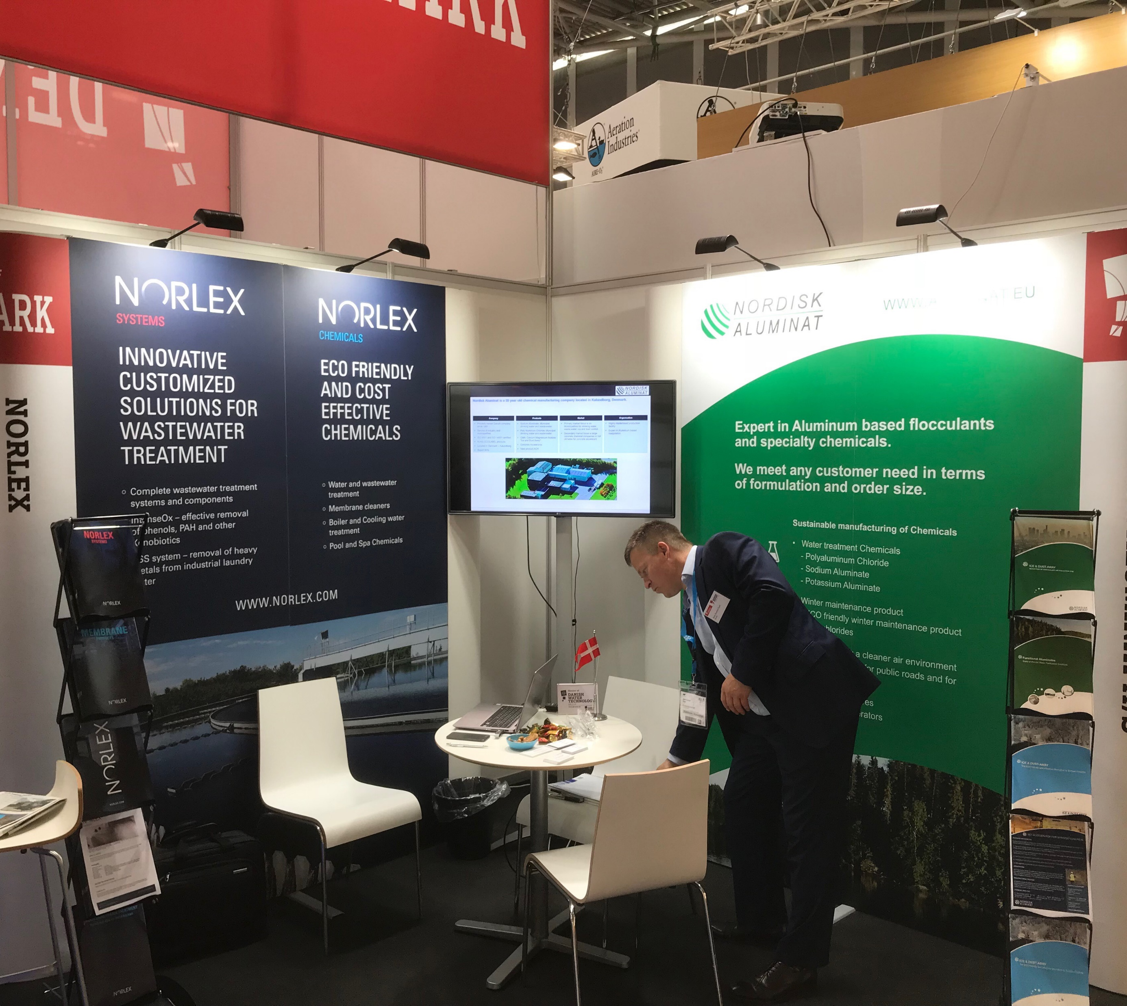
EXPO Posters
Recomended when:
Screen is incorporated in wall
Graphics contain many small details

Slide 5
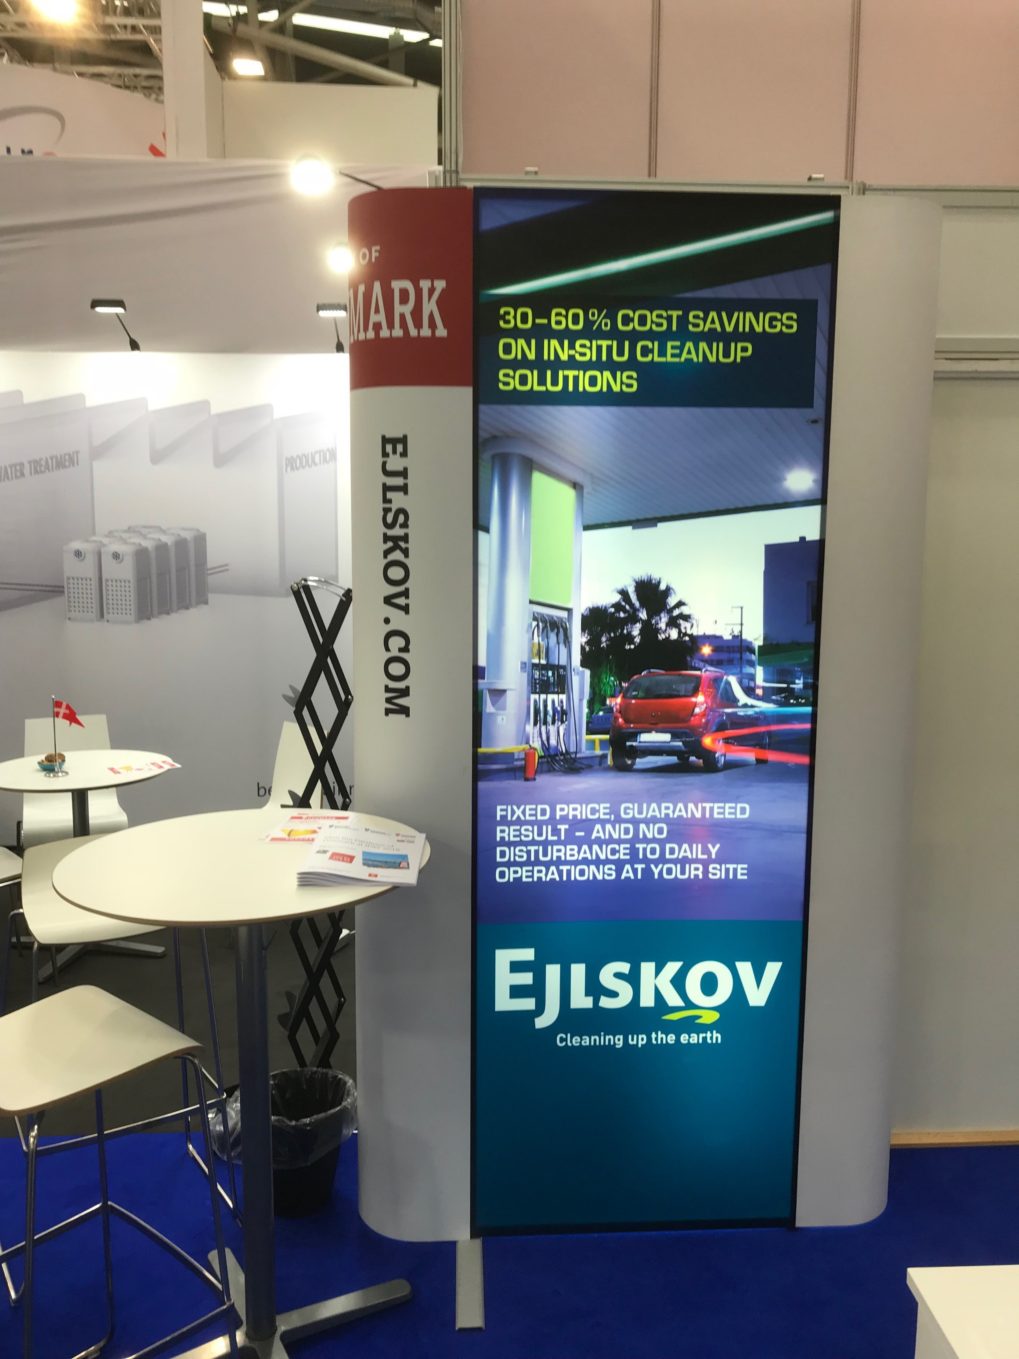
EXPO Posters - back light
Recomended when:
Graphics have many contrasting colors
Highlighting certain details

Slide 6
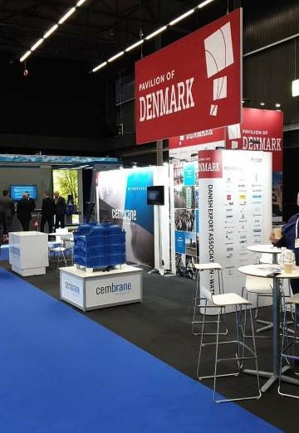
Graphics
Specifications for your print files:
Measurements:
1 poster: w: 780 x h:2367mm
2 posters: w:1560 x h:2367mm
3 posters: w:2340 x h:2367mm
4 posters: w:3120 x h:2367mm
Add 10 mm bleed (crop marks must be invisible)
All text must be outlined
All images must be 100 dpi
All logos in EPS or AI file
All colors will be printed in CMYK
Print ready pdf’s must be sent by www.wetransfer.dk to the Project manager
Standesign offers to produce the printing file. Please order DTP in the order form

Slide 7
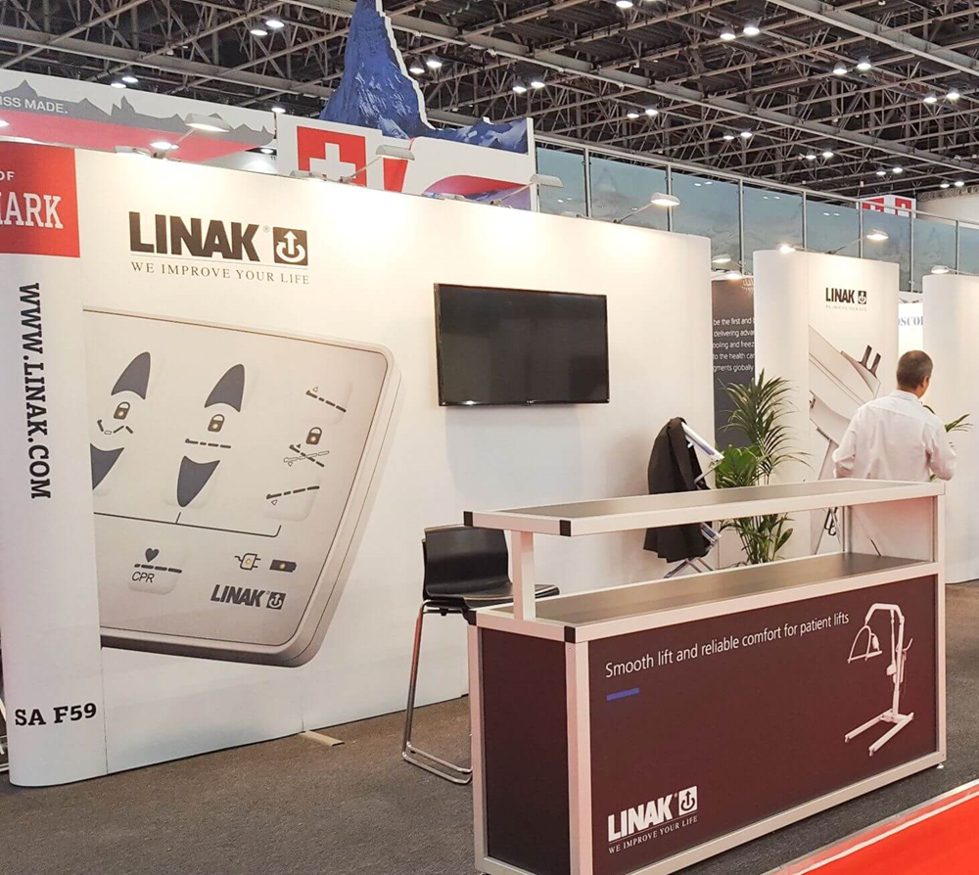
Order form
Please fill out the order form and return by email to:
torben@standesign.dk
Deadline: 27th of April 2022
End curves will have text. Company name or web address in same size and fonts, written in capital letters
Remember to indicate the required text for your end curves in the order form

Slide 8

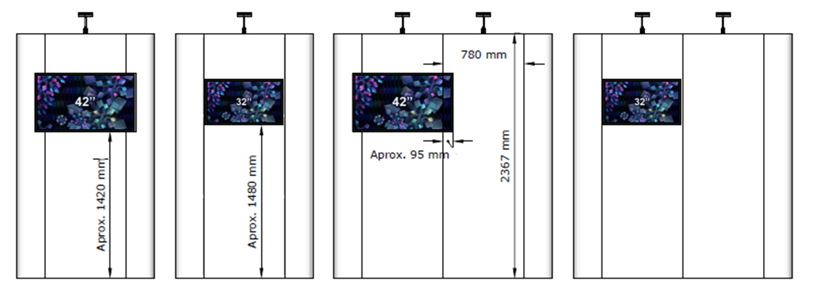
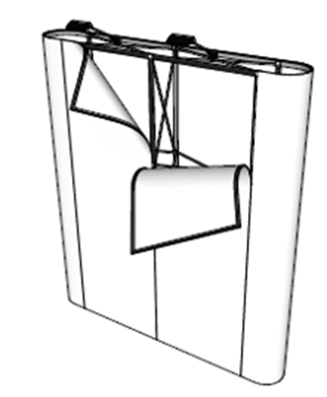
TV-screen on wall
TV screen can be mounted on front (32” and 42”)
TV screen can only be placed at vertical center of each poster

Slide 9
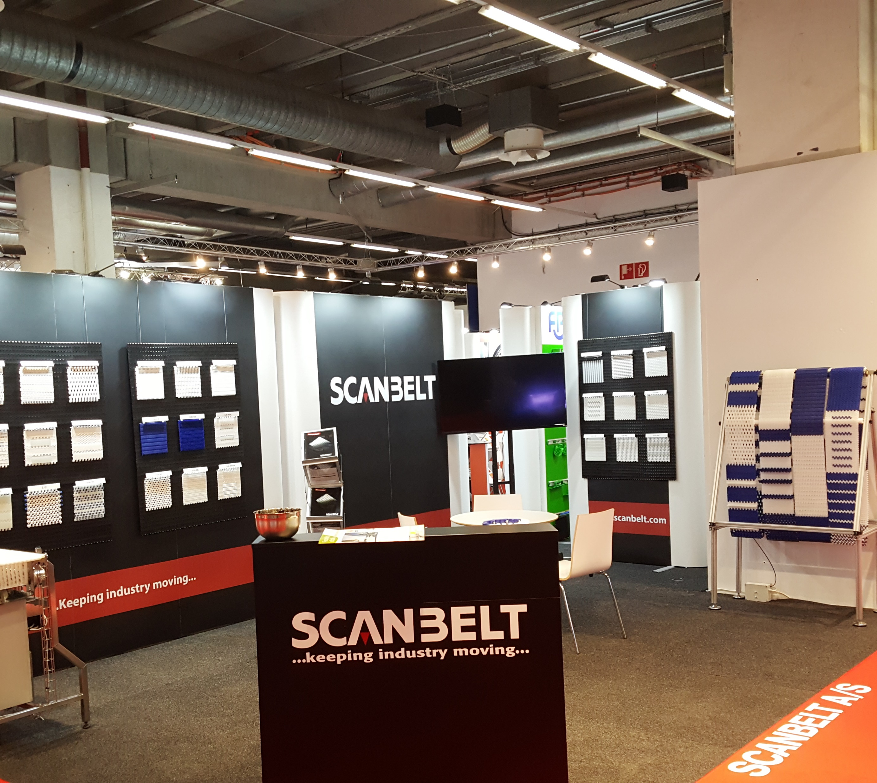
Delivery of stand
Delivery of stand:
29th of May between 14:00 -17:00
All empty goods must be cleared at: 17:00
Halls close at: 18:00

Slide 10


