Slide 1
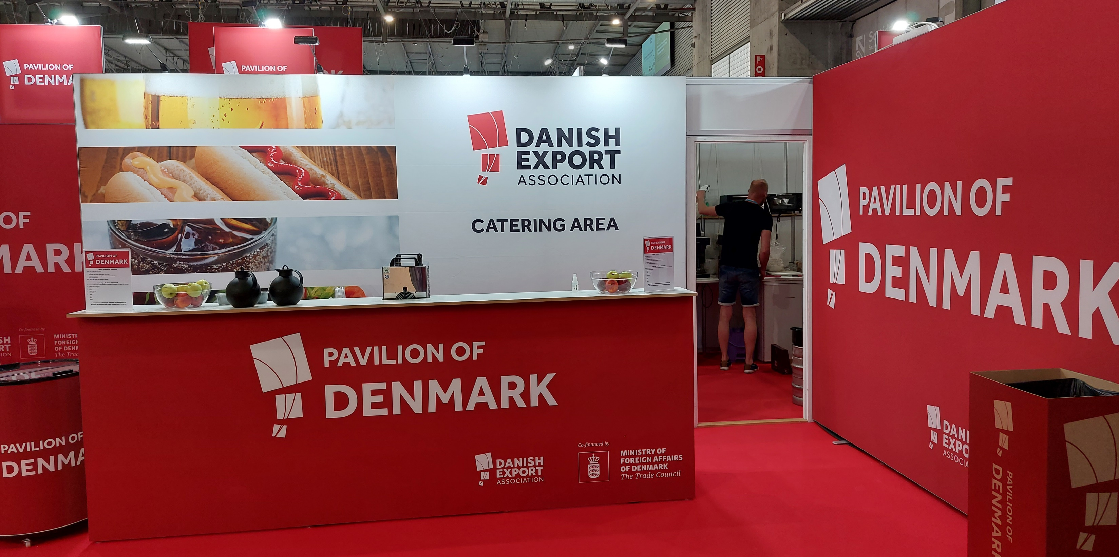
SPNA 2023 BOSTON

Slide 2
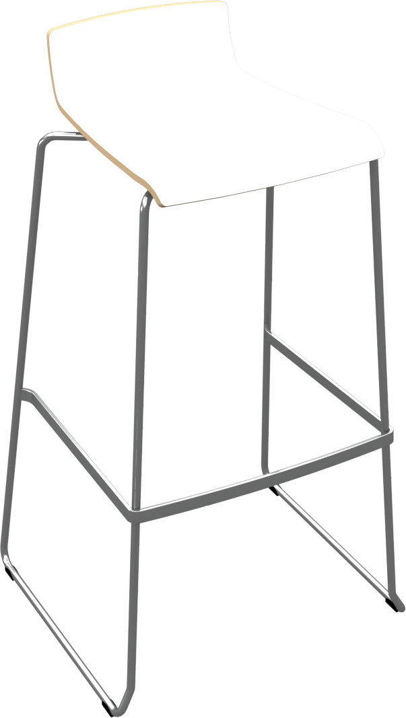
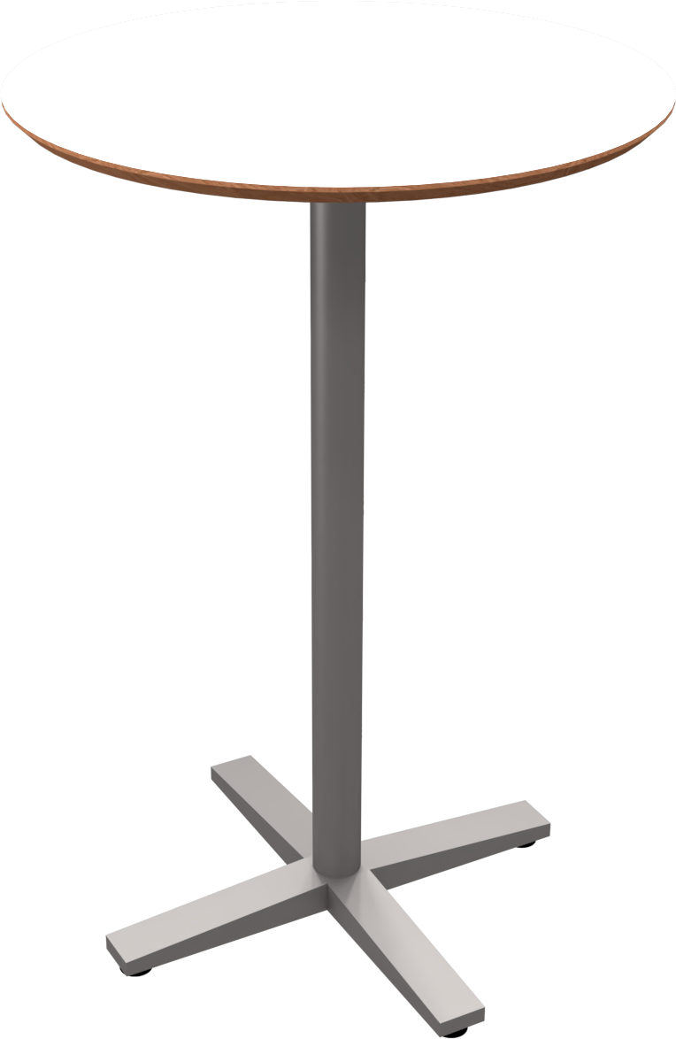
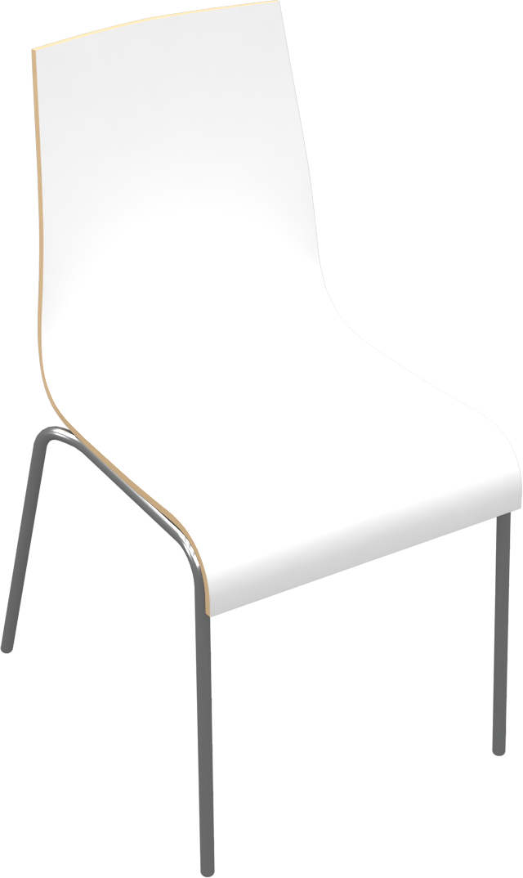
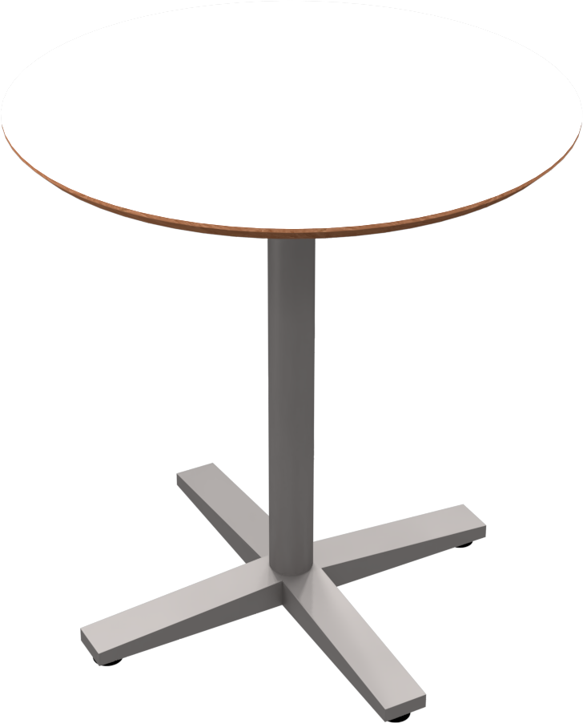
Furniture included in your fee
1 x Table (low or tall)
3 x Chairs or bar chairs
1 x Brochure stand
1 x 220V with approx 300 W for charging phone, laptop etc

Slide 3
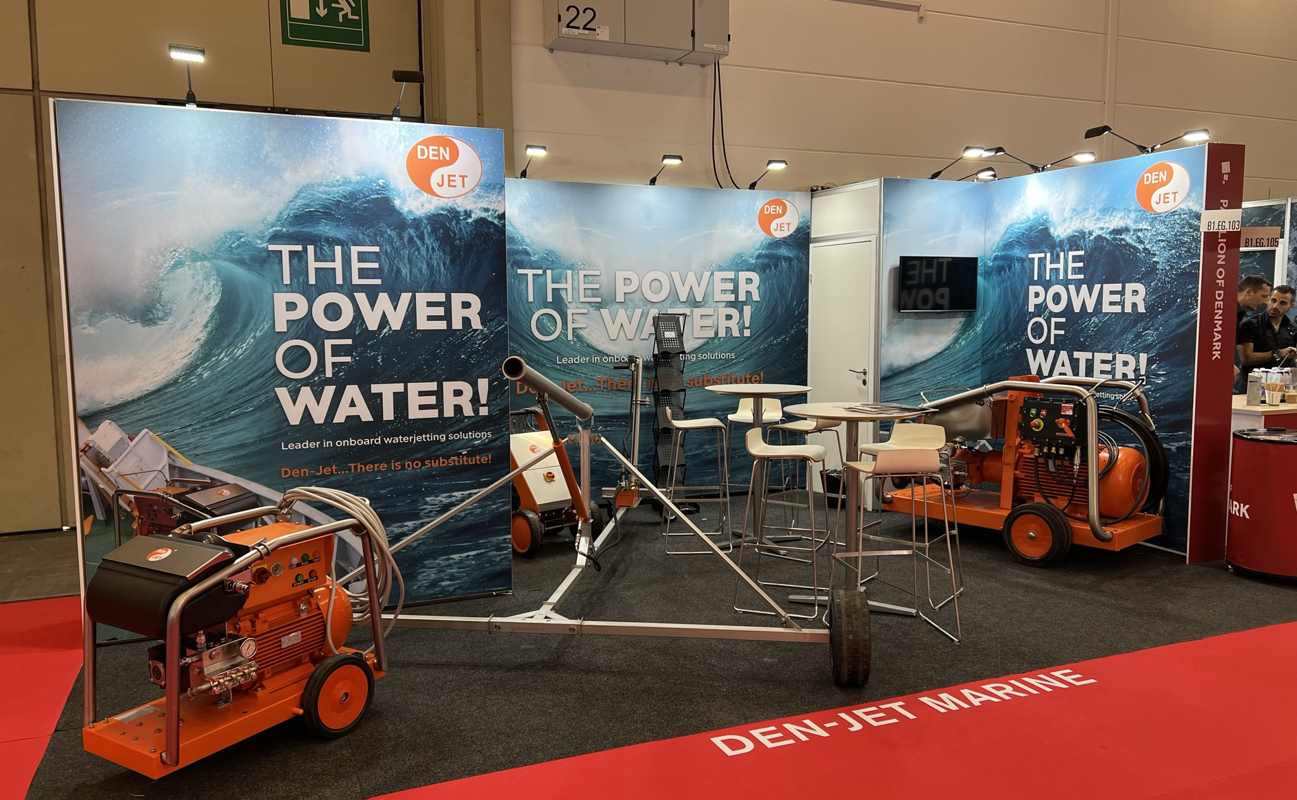
IN Frame Banner
The system is not visible
Large text
and pictures is possible

Slide 4
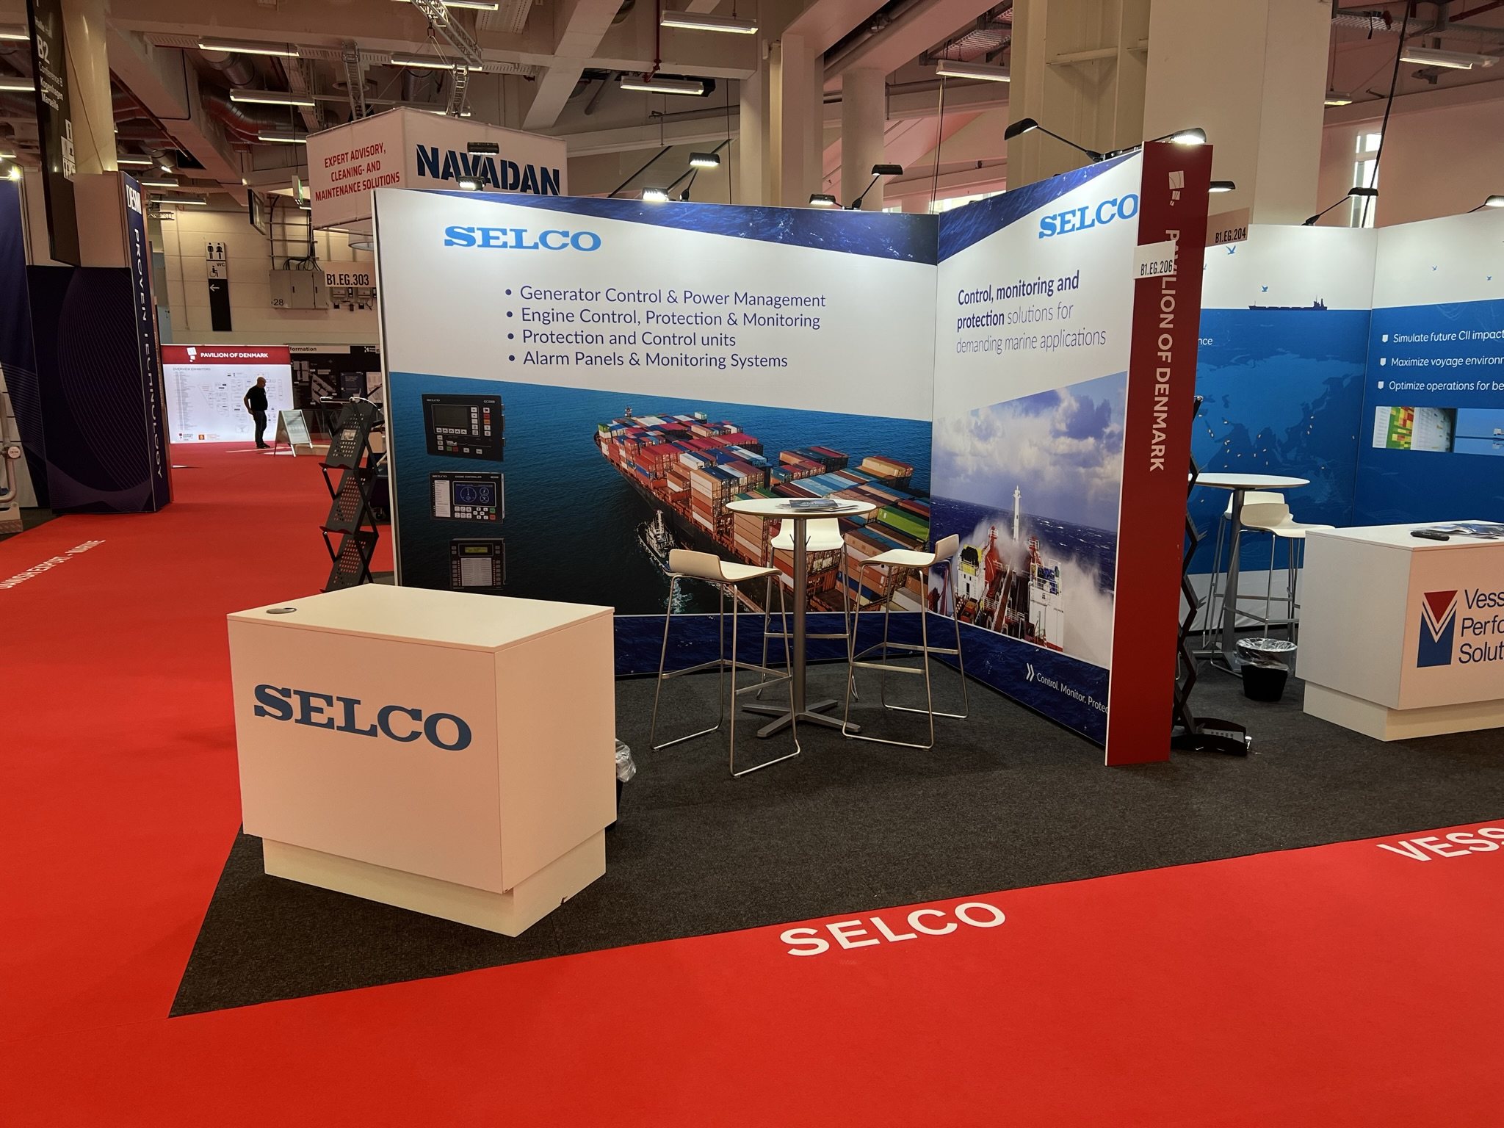
Graphics
The number of m² fabric banner depends on the size of the wall. Please see drawing and Order Form for dimensions or contact the Project Manager for details.
Specifications for your print files:
Add 10 mm bleed
All text must be outlined
All images must be minimum 100 dpi
All logos in EPS or AI file
All colors will be printed in CMYK
Print ready pdf’s must be sent by www.wetransfer.com
Standesign offers to produce the printing file.
Please contact the Project Manager or order DTP in the order form

