Slide 1
LABDAYS 2023 AARHUS
13.09.2023 – 14.09.2023
FORSIDEBILLEDE FRA SAMME MESSE SIDST AFHOLDT
STØRRELSE: H: 9,46 cm x : 33,87 cm
(DET SAMME SOM DENNE BLÅ REKTANGEL)
FYLD UD OG BESKÆR (STRÆK IKKE)
‘PLACER BAGERST >’
SLET DENNE TEKSTBOX + BLÅ REKTANGEL

Slide 2
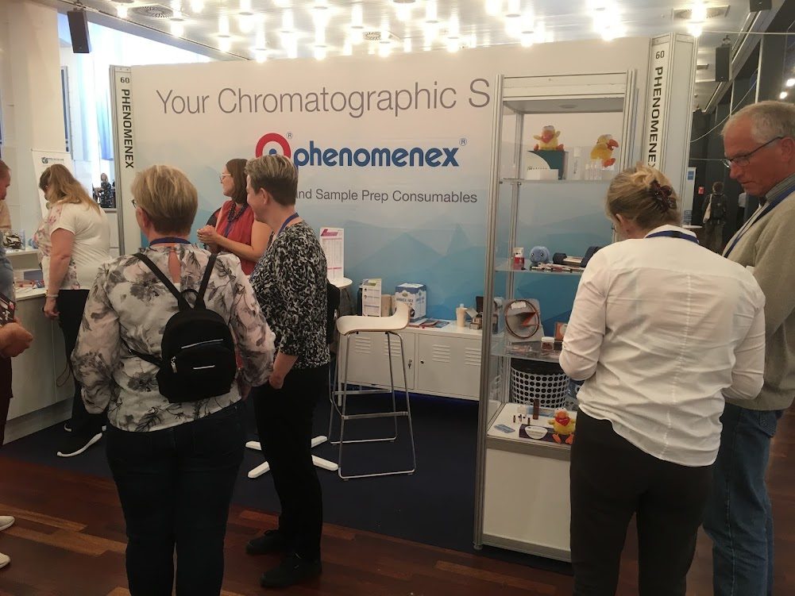
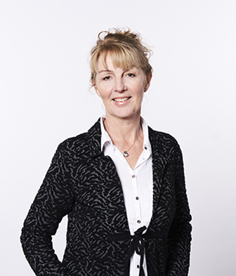
STANDESIGN PROJECT MANAGER
Pernille Kjær
Project Manager
E-mail: pernille@standesign.dk
Phone: +45 21830710
Notes:
You are always welcome to contact me regarding your booth
- In case I am not available, my colleagues are always ready to help

Slide 3
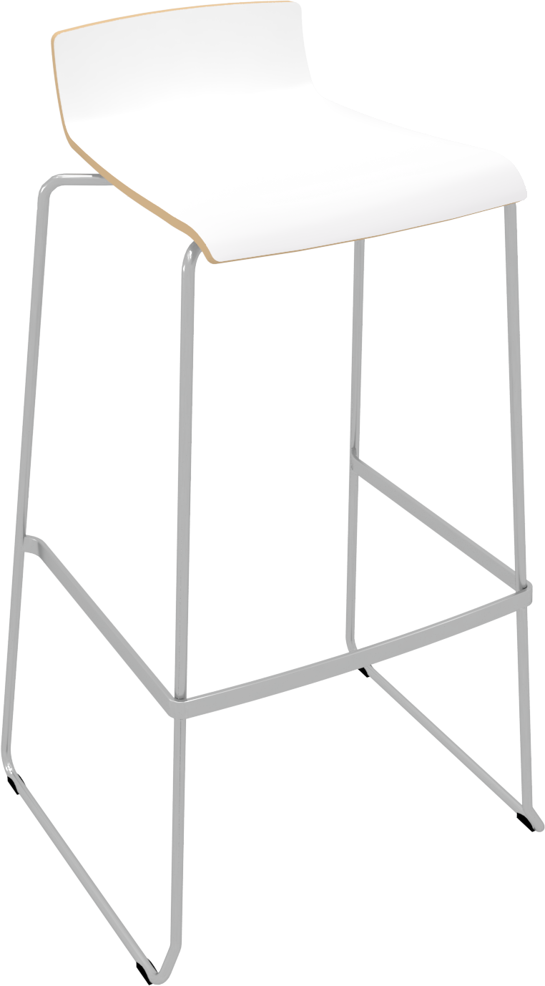
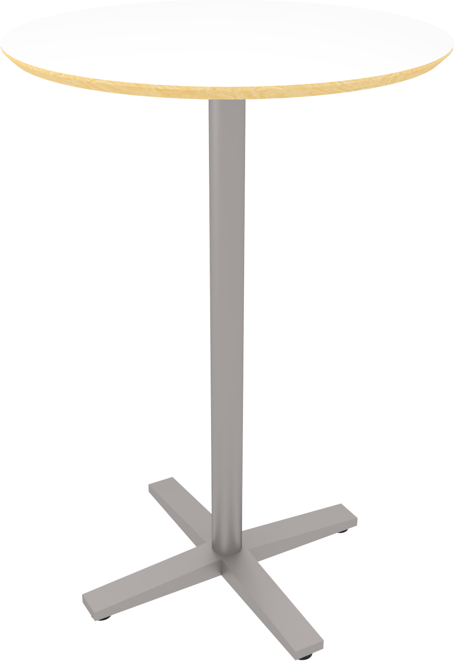
MØBLER INKLUDERET I MØBELPAKKEN - FURNITURE INCLUDED IN YOUR FEE
1 x bord (højt) - 1 x Table (tall)
2 x Bar stole – 2 x Bar chairs
1 x Strømforsyning 1,5 kW– 1 x Power supply 1,5 kW
Virksomhedsnavn på endebanner - Company name on end banners
Notes:
Your participation fee includes a furniture set, consisting of:
1 x table
3 x chairs
1 x brochure
1 x 230w socket for charging phones, laptops etc.
please fill in the order form whether you would like to getting use of the included furniture package
and whether you prefer a high table with bar stools or a low table with chairs
In the order form, you can also order extra furniture, info counters, podiums, etc.
Standesign also offers custom-made podiums and other equipment.
If there is anything else you might need or you have any special requests, do not hesitate to contact me for options and prices
Also let me know, if you need extra power for machine connection, compressed air etc.
Then we will help you find the right solution and make sure that everything is ready when you arrive with your products.

Slide 4
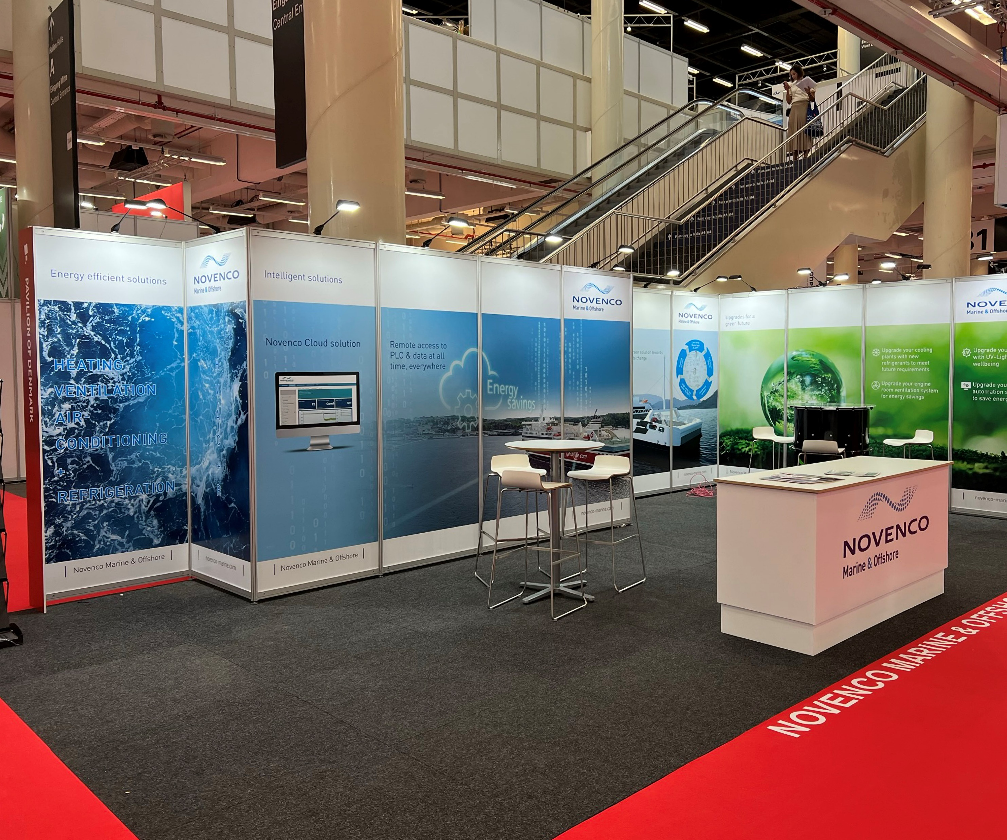
PRINT PÅ VÆG - PRINT ON WALL
Overvej følgende - Take into consideration that:
Systemet er synligt - The system is visible
Print er direkte på panelerne - Print is directly onto the panels
Panelerne kan ikke genbruges - Panels cannot be reused
Example of print on wall
Notes:
We are making use of the EXPO system.
This means that you can either choose to have new posters produced,
or you can recycle posters from previous fairs or exhibitions.
I will be happy to help you with an overview of posters you might have stored in our warehouse, which can be reused

Slide 5
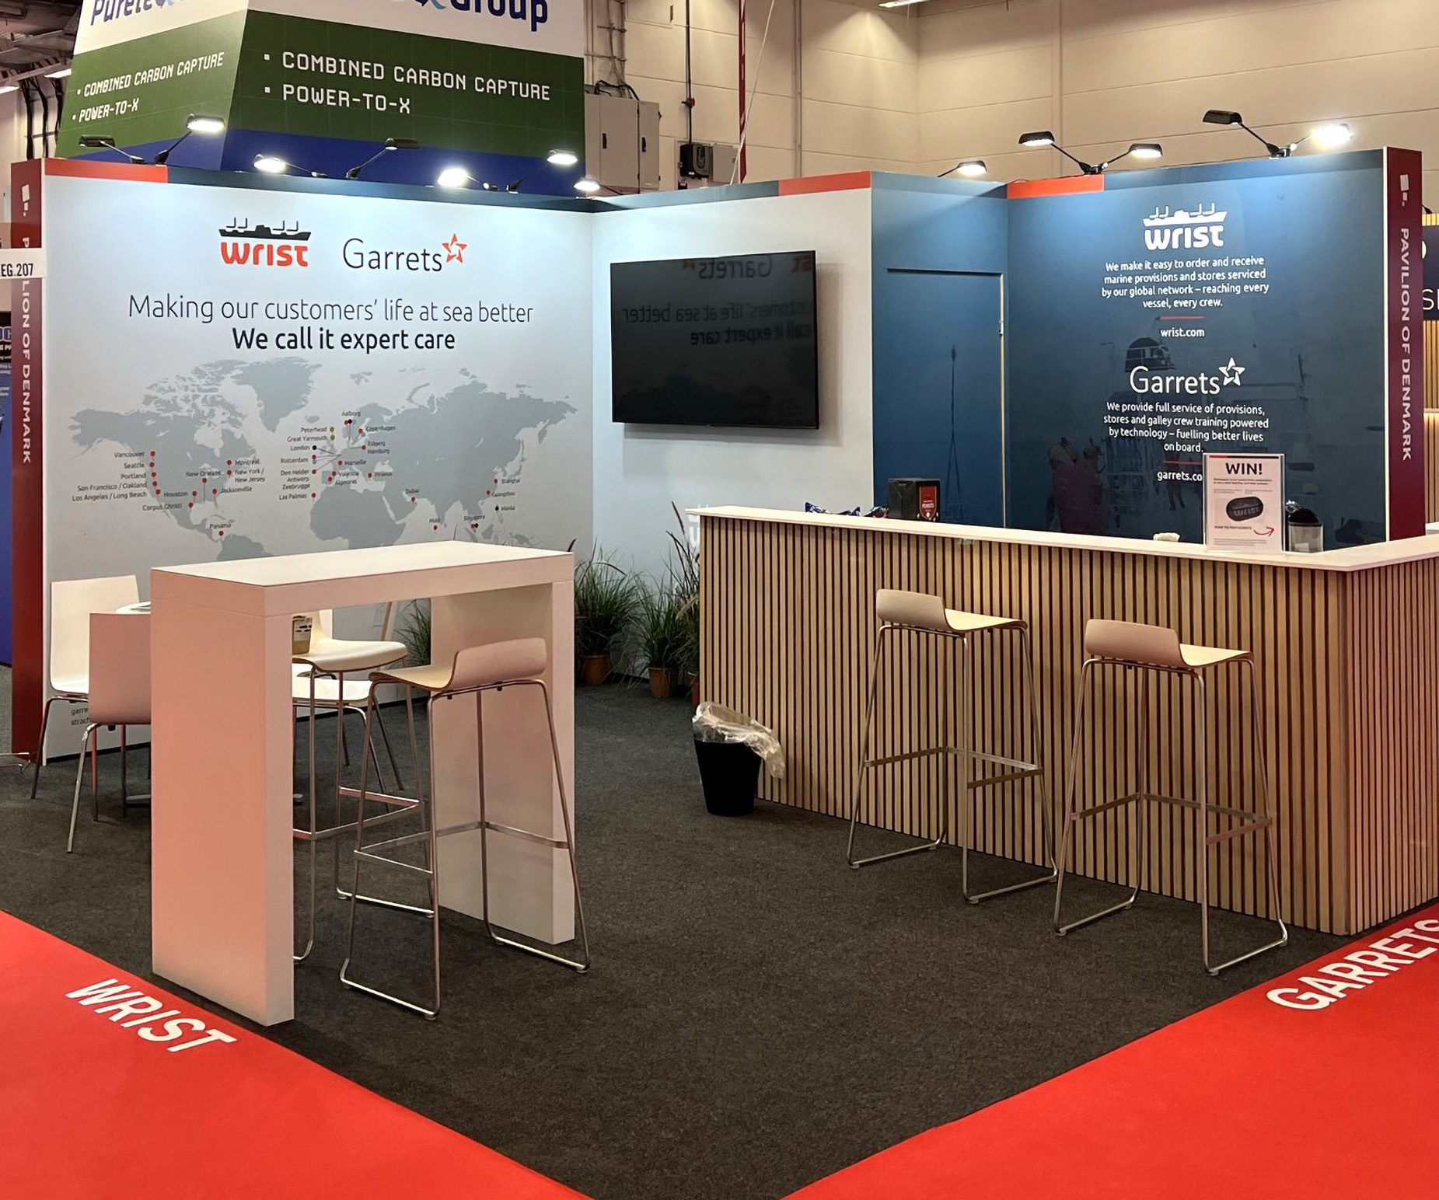
IN FRAME BANNER
Overvej følgende - Take into consideration that:
Systemet er ikke synligt -The system is not visible
Print er i stof monteret i ramme - Print is on fabric mounted in frame
IN Frame Bannere kan genbruges - IN Frame Banners can be reused
Example of in frame banners
Notes:
Expo posters are also available as backlit which is recommended when:
- The graphics have many contrasting colors
You would like to highlight certain details
or just draw some extra attention.

Slide 6
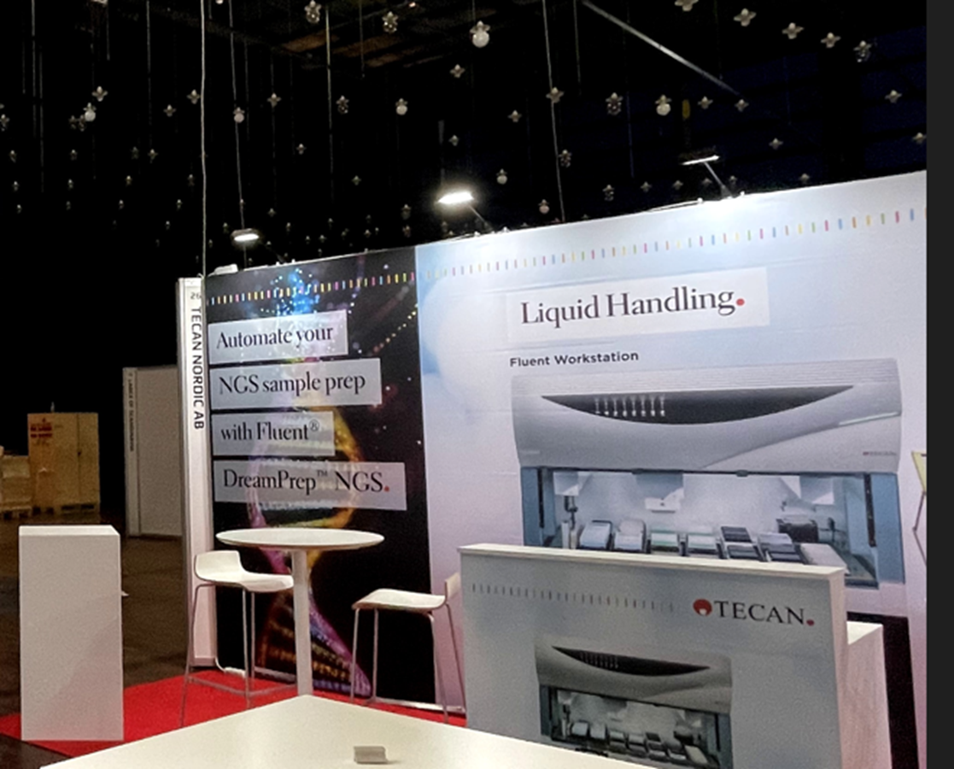
GRAFIK TIL DIN STAND
Antallet af paneler eller m² afhænger af væggens størrelse. Se venligst Tegning og Bestillingsformular for dimensioner eller kontakt projektlederen for detaljer.
Specifikationer for dine printfiler:
Tilføj 20 mm bleed (skæremærker skal være synlige)
Al tekst skal være outlined
Alle billeder skal være minimum 100 dpi
Alle logoer i EPS- eller AI-fil
Alle farver vil blive trykt i CMYK
Printklare pdf’er skal sendes via www.wetransfer.com til projektlederen
Standesign tilbyder at producere printfilen
Bestil venligst DTP i bestillingsformularen
Notes:
Here you will find dimensions and specifications for the print files.
The size and number of walls are shown in the floor plan drawing.
Dimensions and specifications for print on info counters, you will find in our furniture catalog
The print ready pdf’s must be sent to me via WeTransfer no later than 14th of October 2021

Slide 7
GRAPHICS FOR YOUR BOOTH
The number of panels or m² depends on the size of the wall. Please see Drawing and Order Form for dimensions or contact the project manager for details.
Specifications for your print files:
Add 20 mm bleed (crop marks must be visible)
All text must be outlined
All images must be minimum 100 dpi
All logos in EPS or AI file
All colors will be printe in CMYK
Print ready pdf’s must be sent by www.wetransfer.com to the project manager
Standesign offers to produce the printing file
Please order DTP in the order form
Notes:
Here you will find dimensions and specifications for the print files.
The size and number of walls are shown in the floor plan drawing.
Dimensions and specifications for print on info counters, you will find in our furniture catalog
The print ready pdf’s must be sent to me via WeTransfer no later than 14th of October 2021

Slide 8
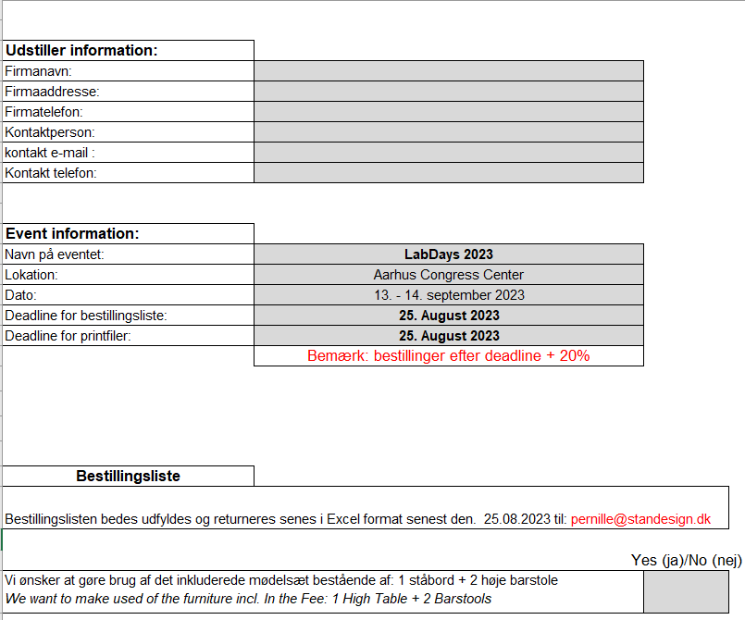
BESTLLINGSLISTE - ORDER FORM
Udfyld bestillingsliste – og send til: - Please fill in the order form and return by email to: Pernille@standesign.dk
Deadline: 25th of August 2023
Notes:
We will make sure that you - after the meeting - receive a link to a landing page on Standesign's website, where you can download our exhibitor documents:
Order Form
Presentation
Furniture Catalog
All “End curves” will have printet company names in same size and font. Remember to indicate the required text for your end curves in the order form
(whether you want a company name with or without ApS etc - or alternatively the company's web address)
Deadline for submitting the completed order form is 1st of October 2021

Slide 9
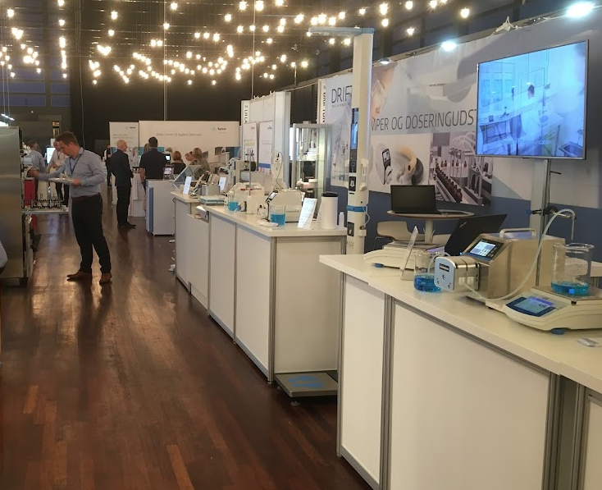
STANDOVERDRAGELSE - STAND HANDOVER
12th of September 2023 - from 8.00 AM
Notes:
We look forward to delivering your booths on Monday 22 November,
where I - and the rest of the Standesign team - will be present and ready to assist you with the final details between 12 am to 3 pm
All aisles must be cleared at 5.30 pm and the halls close at 6pm

