Slide 1

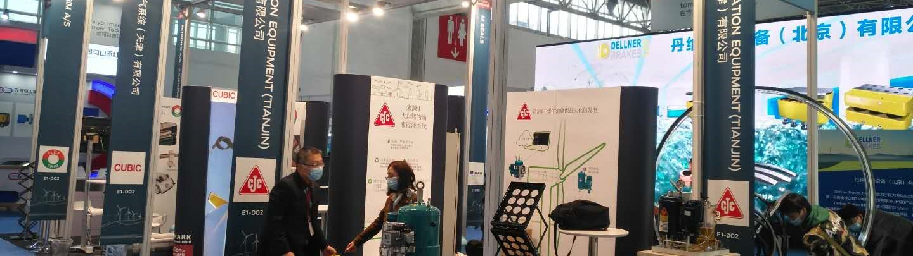

CHINA WIND POWER 2023 BEJING
17.10.2023 – 19.10.2023

Slide 2
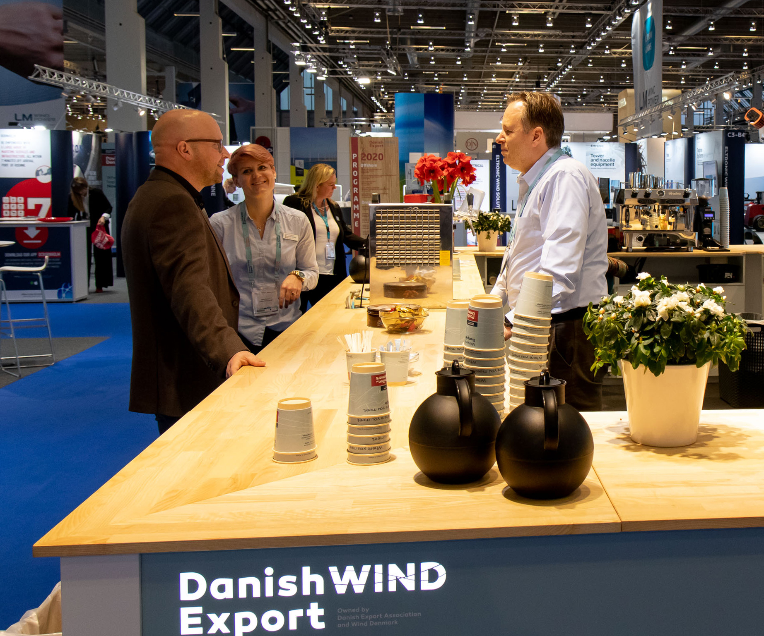


STANDESIGN PROJECT MANAGER
Jacob Justesen
Project Manager
E-mail: jacob.justesen@standesign.dk
Phone: +45 21 55 49 62
Notes:
You are always welcome to contact me regarding your booth
- In case I am not available, my colleagues are always ready to help

Slide 3
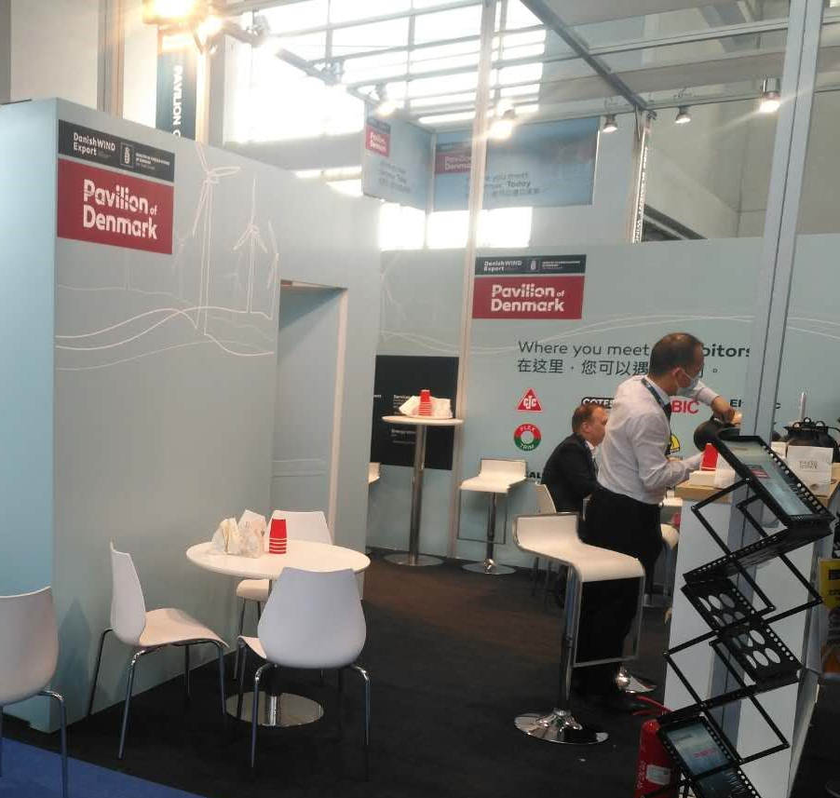
FURNITURE INCLUDED IN YOUR FEE
1 x Table (low or tall)
3 x Chairs or bar chairs
1 x Brochure stand
1 x 220V with approx. 300 W for charging phone, laptop etc
Notes:
Your participation fee includes a furniture set, consisting of:
1 x table
3 x chairs
1 x brochure
1 x 230w socket for charging phones, laptops etc.
please fill in the order form whether you would like to getting use of the included furniture package
and whether you prefer a high table with bar stools or a low table with chairs
In the order form, you can also order extra furniture, info counters, podiums, etc.
Standesign also offers custom-made podiums and other equipment.
If there is anything else you might need or you have any special requests, do not hesitate to contact me for options and prices
Also let me know, if you need extra power for machine connection, compressed air etc.
Then we will help you find the right solution and make sure that everything is ready when you arrive with your products.

Slide 4
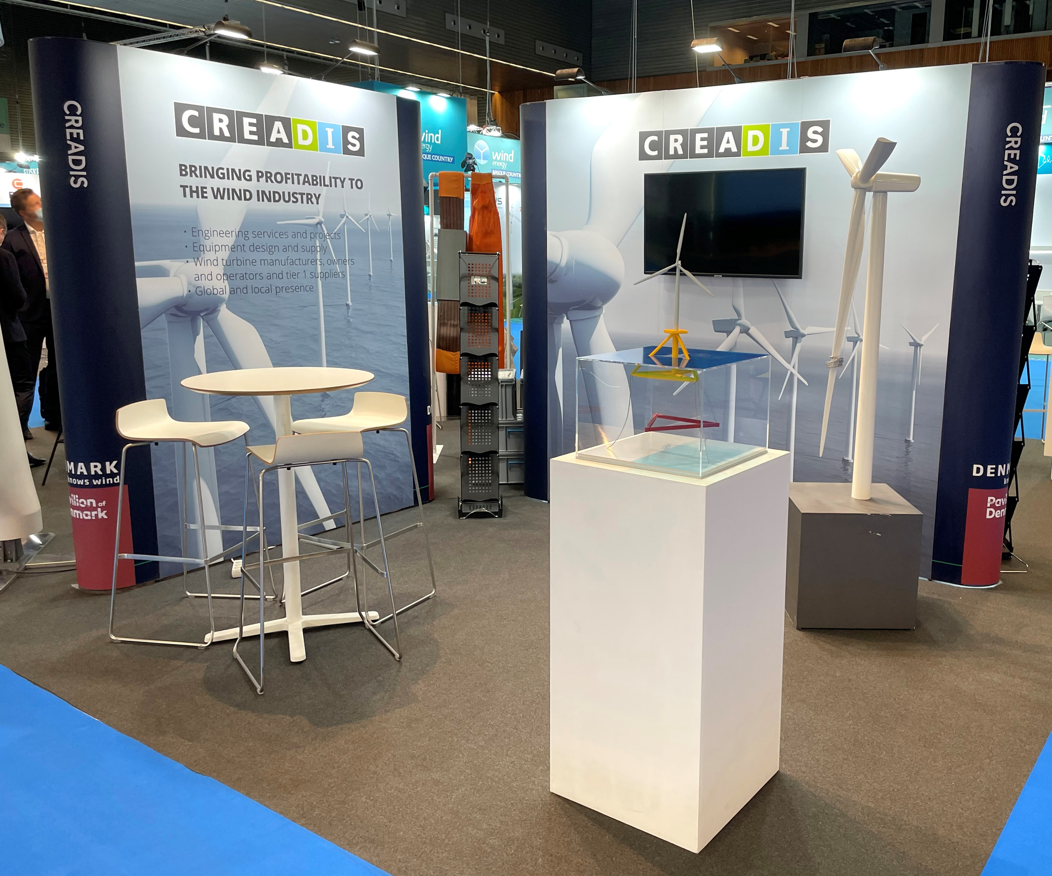
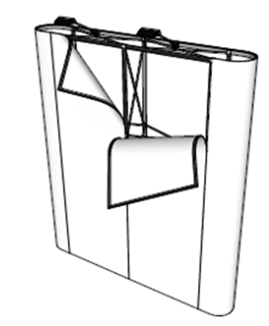
EXPO POSTERS
Recommended when:
Monitor is incorporated in wall
Graphics contain many small details
Notes:
We are making use of the EXPO system.
This means that you can either choose to have new posters produced,
or you can recycle posters from previous fairs or exhibitions.
I will be happy to help you with an overview of posters you might have stored in our warehouse, which can be reused

Slide 5
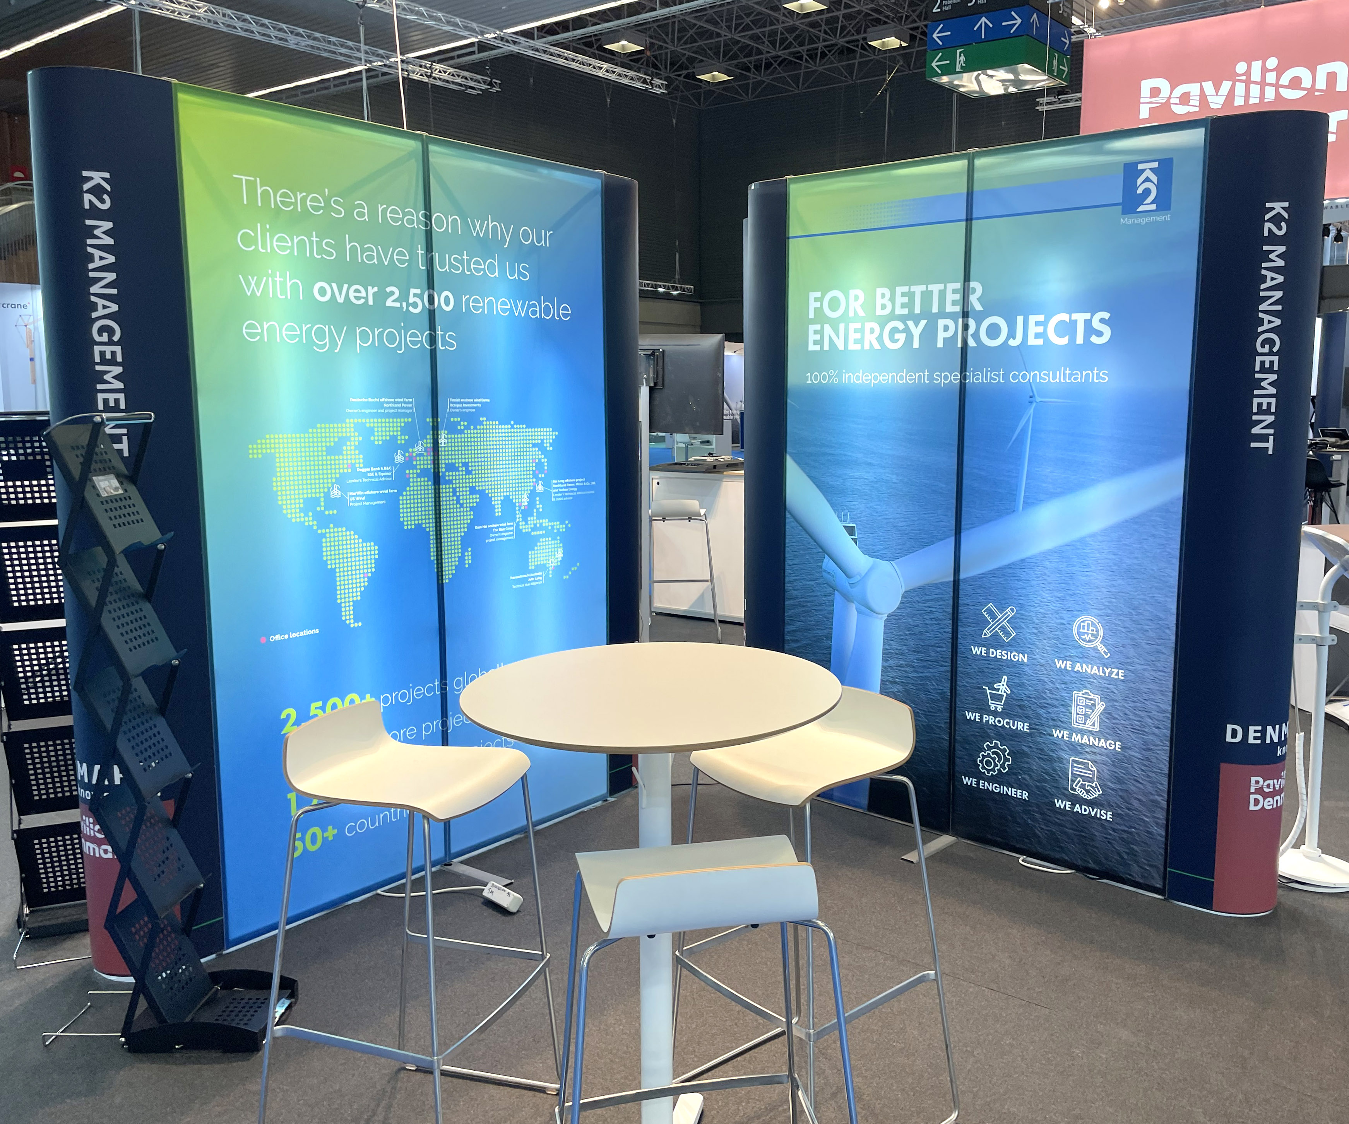
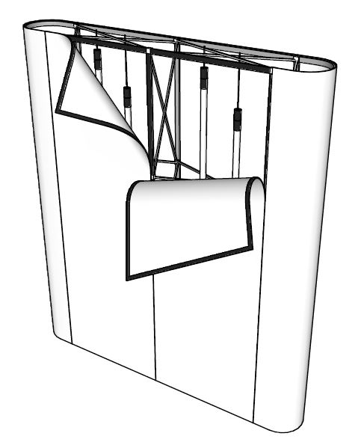
EXPO POSTERS - BACKLIT
Recommended when:
Graphics have many contrasting colors
Highlighting certain details
Notes:
Expo posters are also available as backlit which is recommended when:
- The graphics have many contrasting colors
You would like to highlight certain details
or just draw some extra attention.

Slide 6
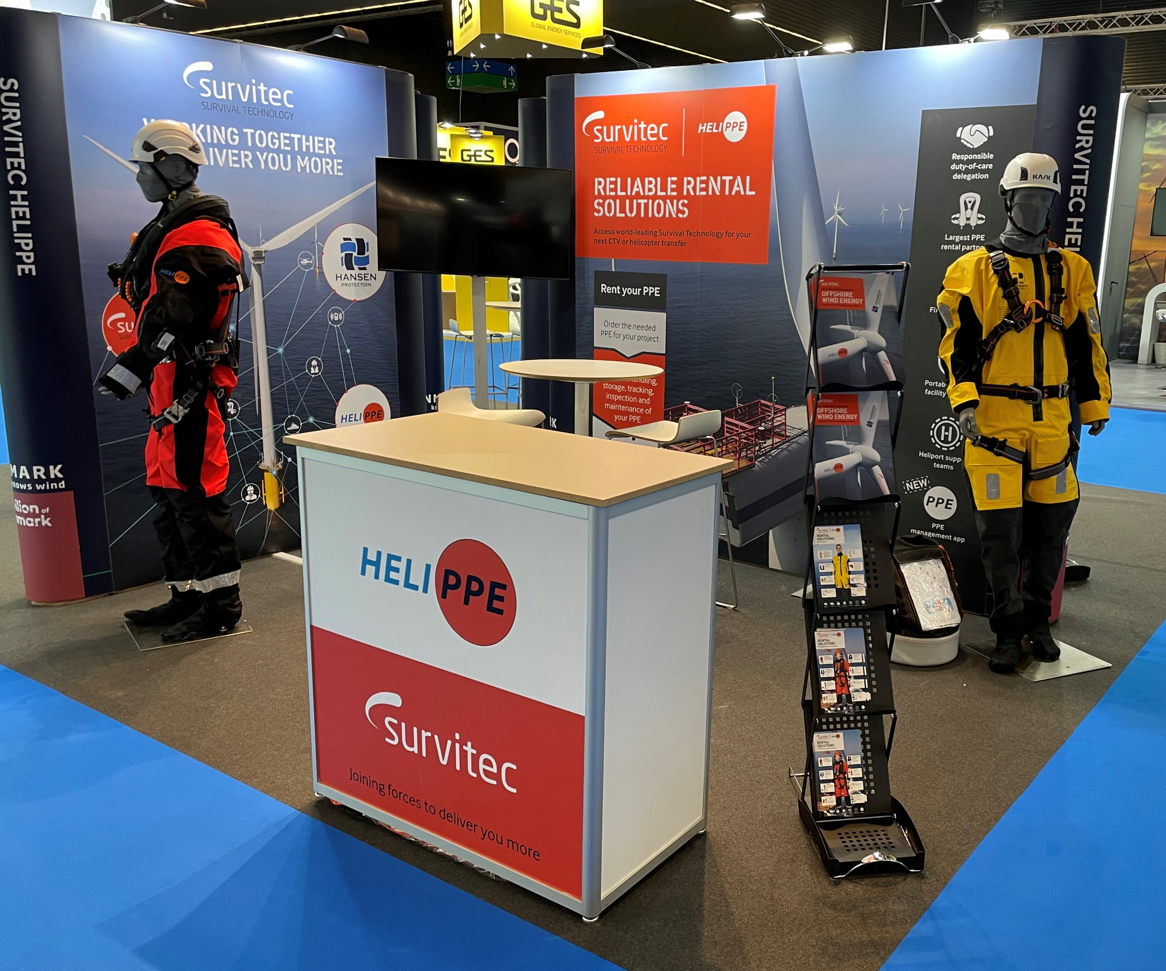
GRAPHICS FOR YOUR BOOTH
See drawings for number of posters on your booth
Graphics dimensions:
1 poster: w: 780 x h: 2367mm
2 posters: w: 1560 x h: 2367mm
3 posters: w: 2340 x h: 2367mm
4 posters: w: 3120 x h: 2367mm
Specifications for your print files:
Add 10 mm bleed (crop marks must be visible)
All text must be outlined
All images must be minimum 100 dpi
All logos in EPS or AI file
All colors will be printed in CMYK
Print ready pdf’s must be sent by www.wetransfer.dk to the project manager
Standesign offers to produce the printing file.
Please order DTP in the order form
Notes:
Here you will find dimensions and specifications for the print files.
The size and number of walls are shown in the floor plan drawing.
Dimensions and specifications for print on info counters, you will find in our furniture catalog
The print ready pdf’s must be sent to me via WeTransfer no later than 14th of October 2021

Slide 7

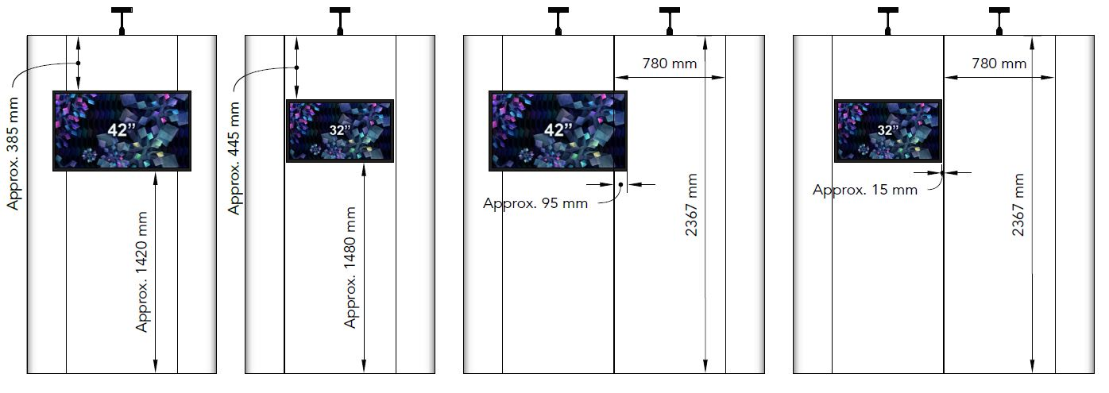
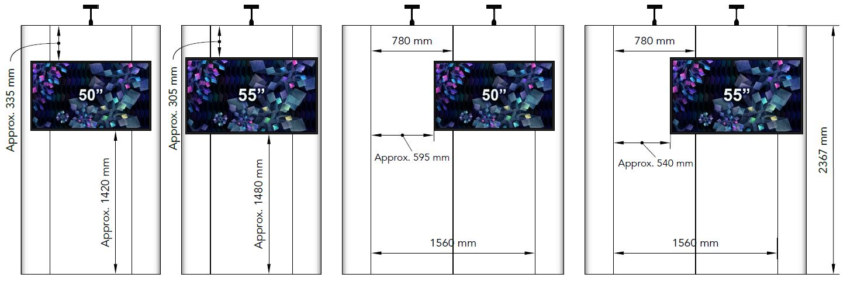
MONITOR ON EXPO WALL WITH 1 POSTER
Monitors can be mounted on front (32”, 42”, 50” and 55”)
Can only be placed at the vertical center of the poster
Notes:
It is possible to mount TV screens on the expo walls in either 32 "or 42"
Please note that screens can only be placed in the vertical center of each poster.

Slide 8
MONITOR ON EXPO WALL WITH 2 POSTERS
Monitors can be mounted on front (32”, 42”, 50”and 55”)
Is as standard placed at the vertical center of each poster
Notes:
It is possible to mount TV screens on the expo walls in either 32 "or 42"
Please note that screens can only be placed in the vertical center of each poster.

Slide 9
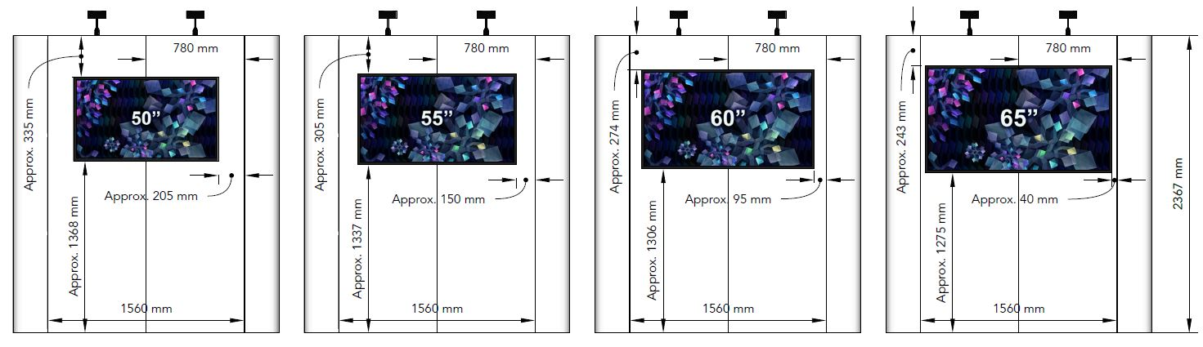
MONITOR ON EXPO WALL WITH 2 POSTERS – MID-POSITION
Monitors can be mounted on front (50”, 55”, 60” and 65”)
Can with special equipment be placed at the center of the EXPO wall
Notes:
It is possible to mount TV screens on the expo walls in either 32 "or 42"
Please note that screens can only be placed in the vertical center of each poster.

Slide 10
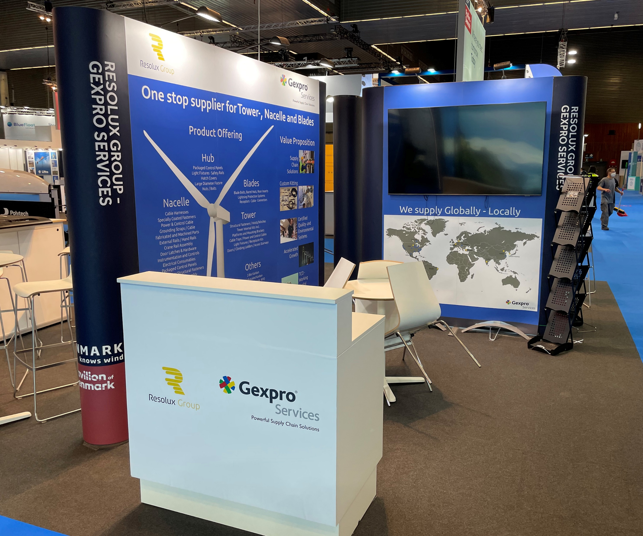
ORDER FORM
Please fill out the order form and return by email to: jacob.justesen@standesign.dk
Deadline: 7th of August 2023
End curves will have text. Company name or web address in same size and font. Remember to indicate the required text for your end curves in the order form
Notes:
We will make sure that you - after the meeting - receive a link to a landing page on Standesign's website, where you can download our exhibitor documents:
Order Form
Presentation
Furniture Catalog
All “End curves” will have printet company names in same size and font. Remember to indicate the required text for your end curves in the order form
(whether you want a company name with or without ApS etc - or alternatively the company's web address)
Deadline for submitting the completed order form is 1st of October 2021

Slide 11
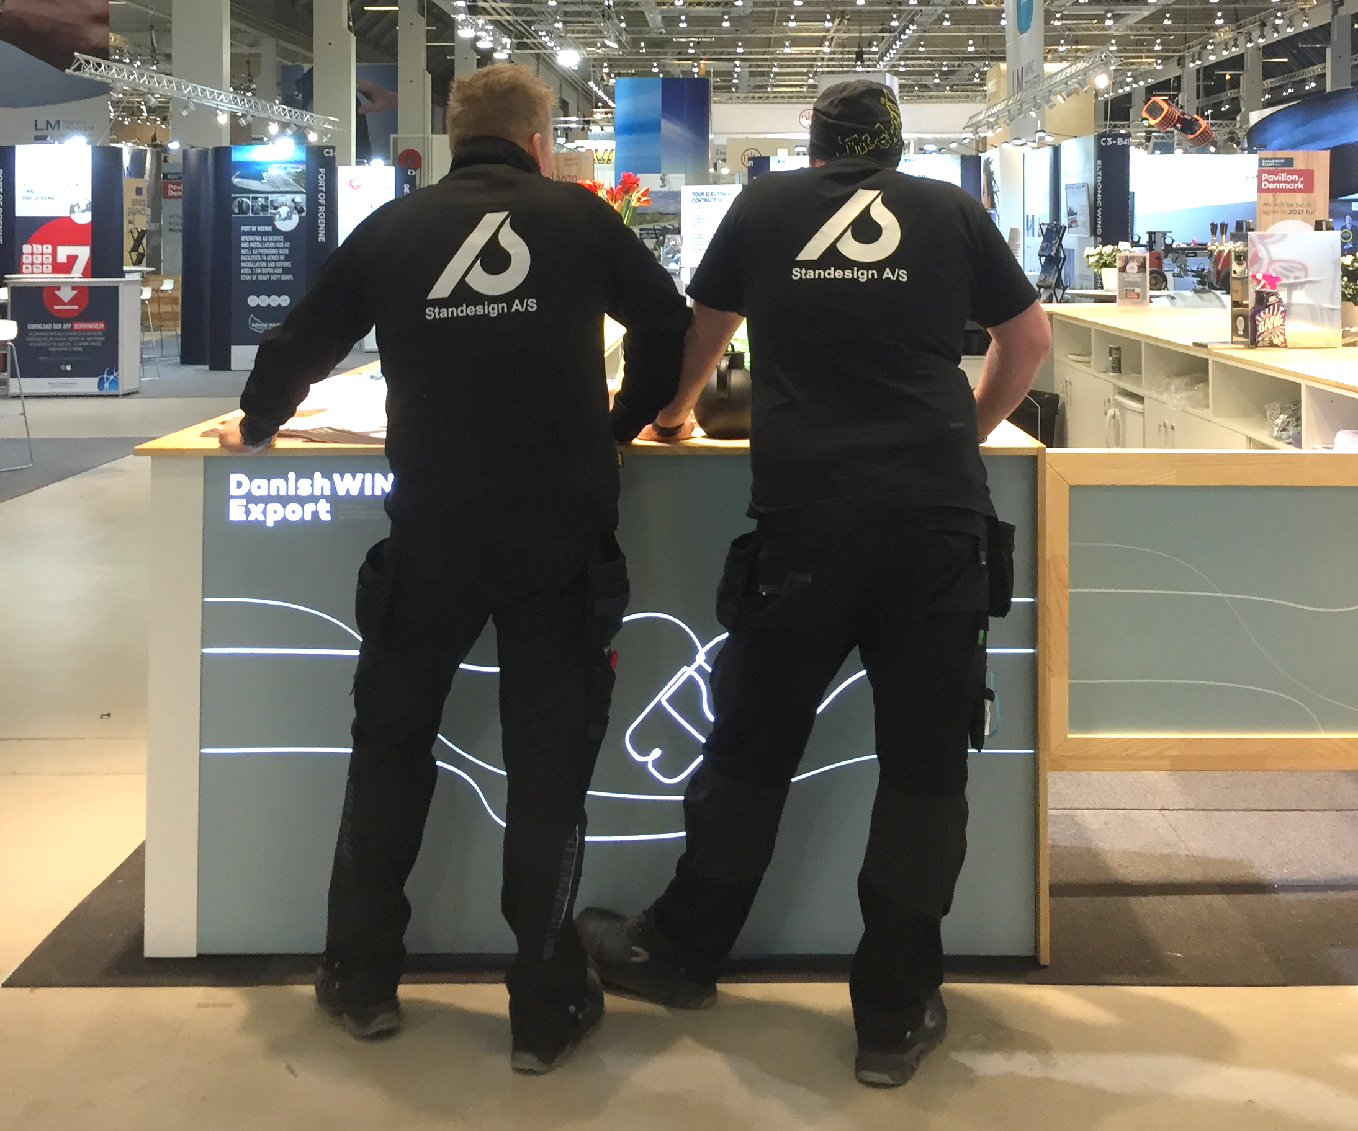
HANDLING OF YOUR GOODS
Standesign can help you handling your own equipment (unpacking and packing)
Must be ordered in advance via the order form
Please indicate estimated hours and provide the following information:
Arrival of the goods
Amount of crates
Please note: We only empty the crates. We do not assemble your equipment
Notes:
If you might need help unpacking and packing your equipment Standesign can help you
Remember to order labour in advance via the order form and inform us about:
Time of arrival of the goods
As well as the amount of crates
Please notice, that we do not assemble or connect your equipment

Slide 12
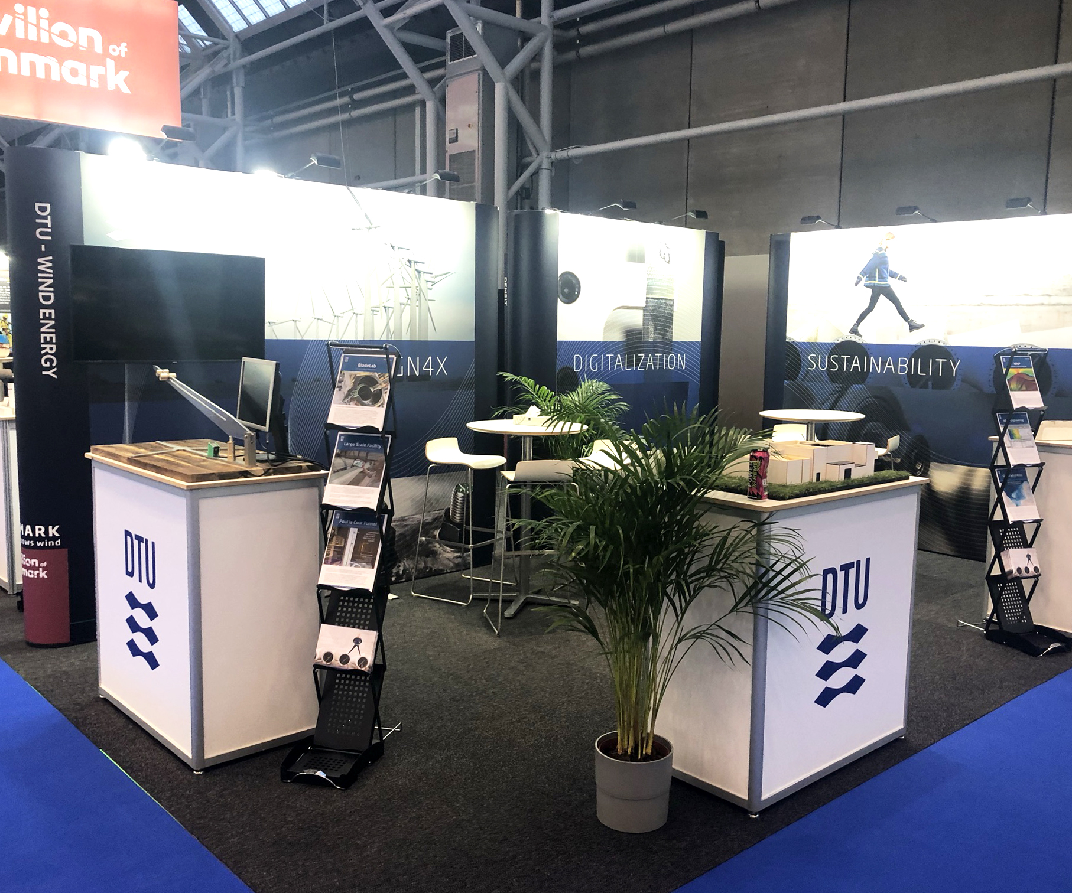
STAND HANDOVER
Stand handover:
16th of October 2023 between 14.00 - 16.00
Stands must be completed, and excess products and materials must be removed from all halls no later than 18.00 on Monday 16th of October – please allow time to load and unload vehicles.
During build up and breakdown, contractors and exhibitors are required to wear build up/breakdown passes and Personal Protective Equipment at all times and to comply with the Health and Safety Regulations of the venue
Notes:
We look forward to delivering your booths on Monday 22 November,
where I - and the rest of the Standesign team - will be present and ready to assist you with the final details between 12 am to 3 pm
All aisles must be cleared at 5.30 pm and the halls close at 6pm

Slide 13


