Slide 1

STAND OUT
Inspiration for your business event
CHINA WIND POWER 2026 BEIJING
14.10.2026 - 16.10.2026
CONSULTING DESIGN CRAFTSMANSHIP TECHNOLOGY

Slide 2
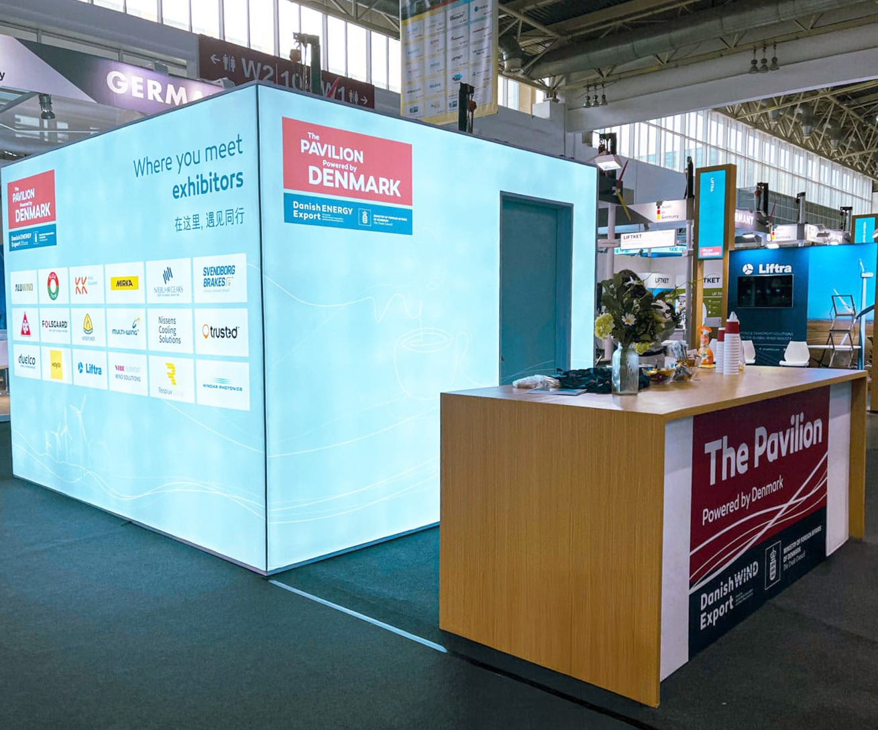


STANDESIGN PROJECT MANAGER
Jacob Stig Justesen
Project Manager
E-mail: jacob@standesign.dk Phone: +45 53 81 52 30

Slide 3
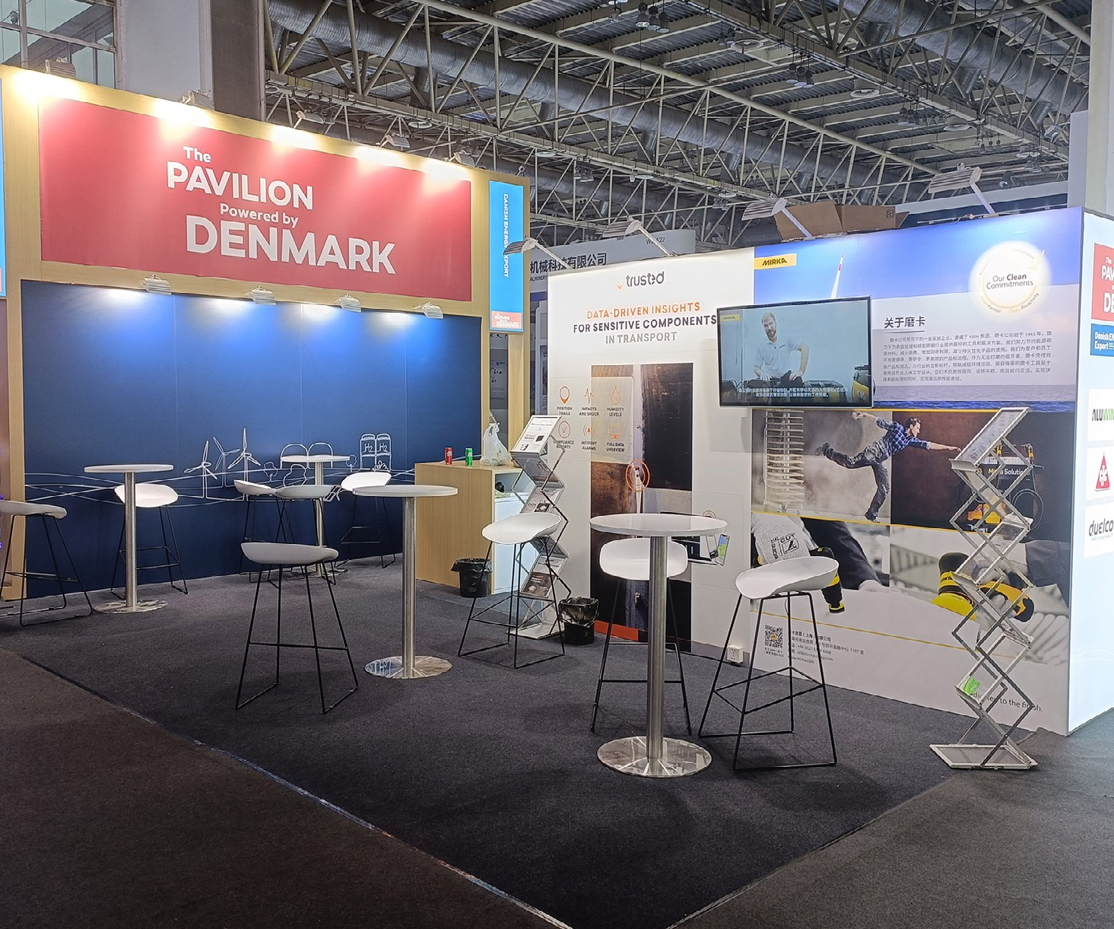
FURNITURE INCLUDED IN YOUR FEE
1 x Table (standard / bar)
3 x Chairs (standard / bar)
1 x Brochure Stand
1 x 220V with approx. 300W for charging phone, laptop etc.

Slide 4
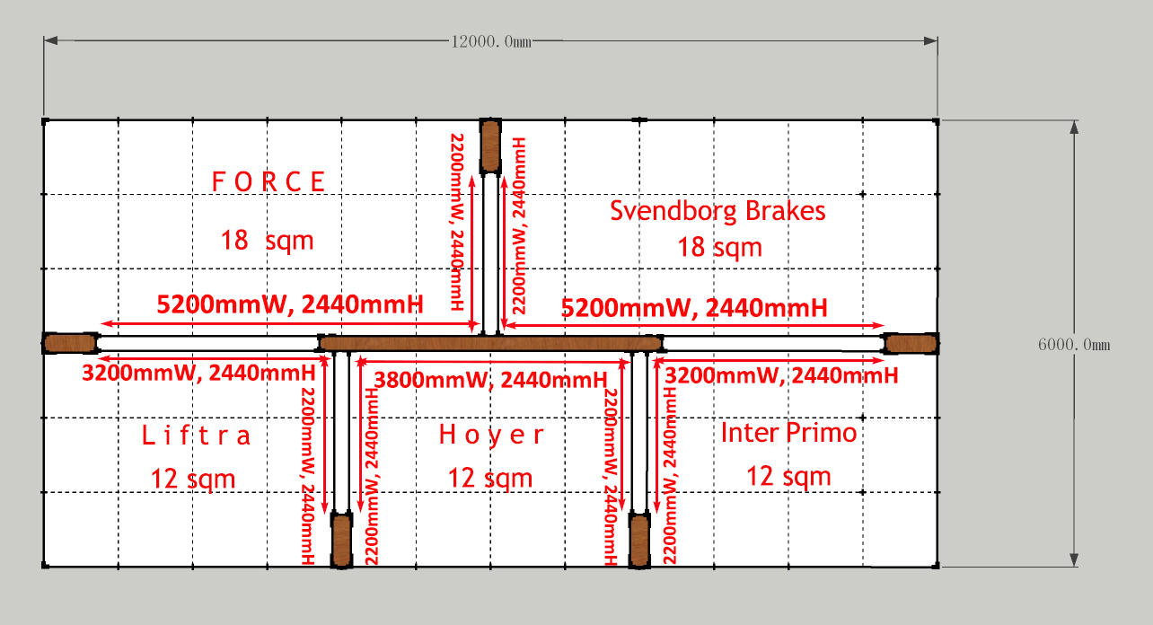
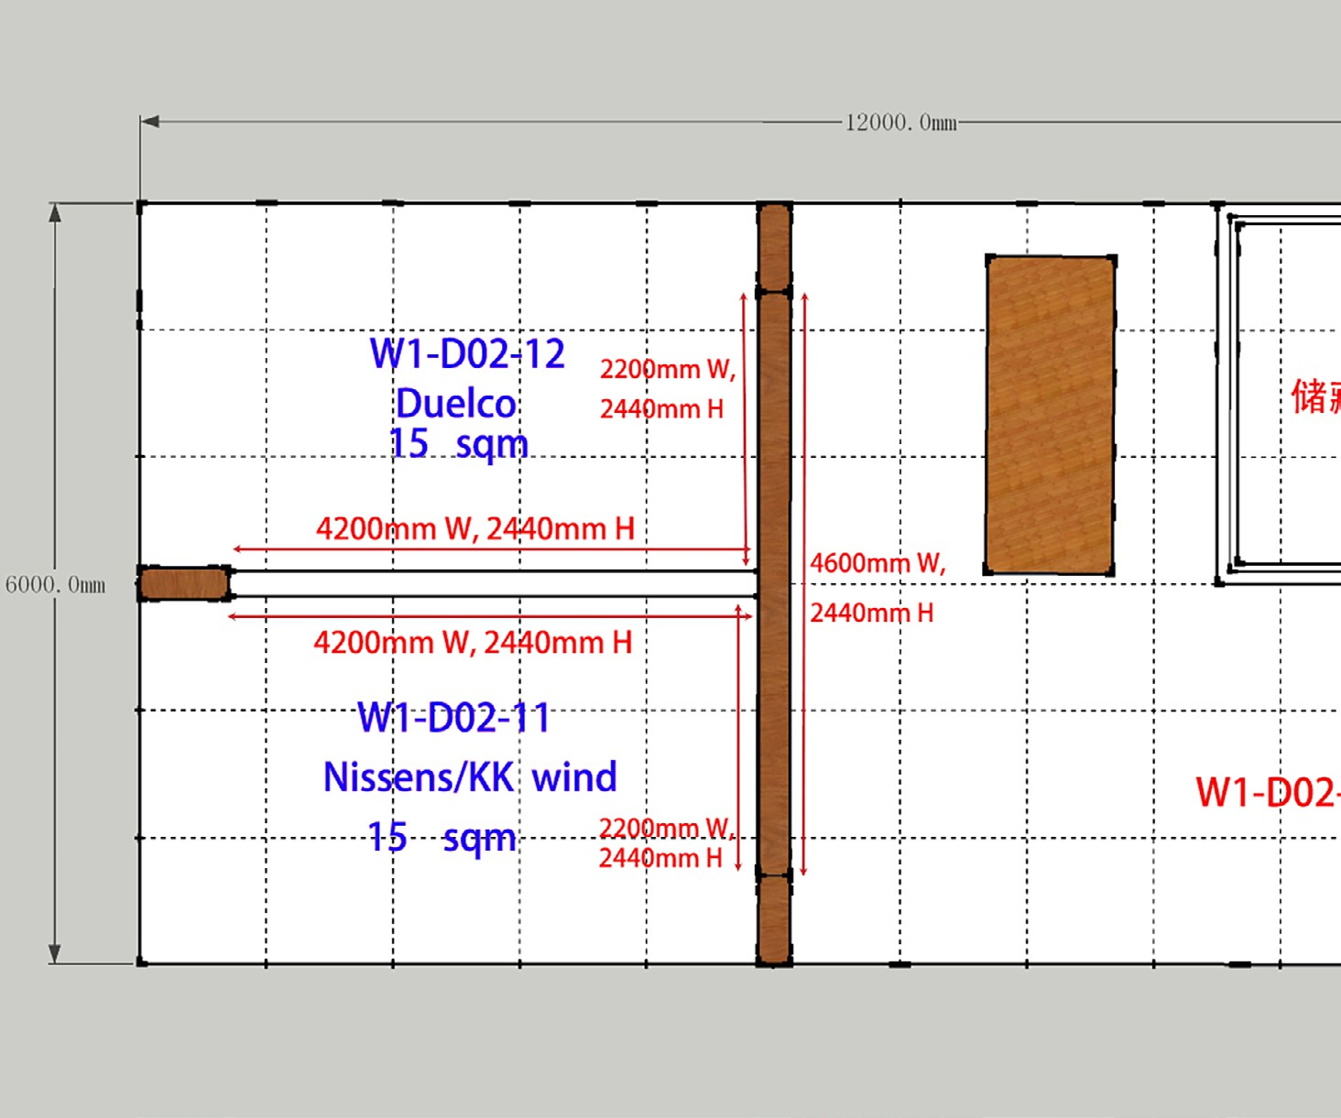
GRAPHICS FOR YOUR BOOTH
Please download the document; ‘Graphics Dimensions’ from the landing page to see sizes of graphics for your booth
Print ready pdf’s must be sent by www.wetransfer.com to the project manager – See ‘Order Form’ for deadline
Standesign offers to produce the printing file
Please order DTP in the order form

Slide 5
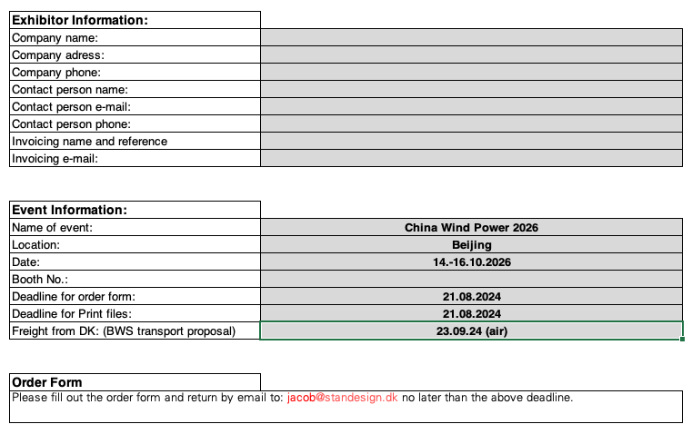
ORDER FORM
Please fill out the order form and return by email to:
jacob@standesign.dk
Deadline: 21th of August 2026
End sign will have text. Company name or web address in same size and font.
Remember to indicate the required text for your booth in the order form

Slide 6

LANDING PAGE
You will receive a link to a landing page on Standesign’s website, where you can download our exhibitor documents:
Order Form
Presentation
Drawings
Furniture Catalogue

Slide 7
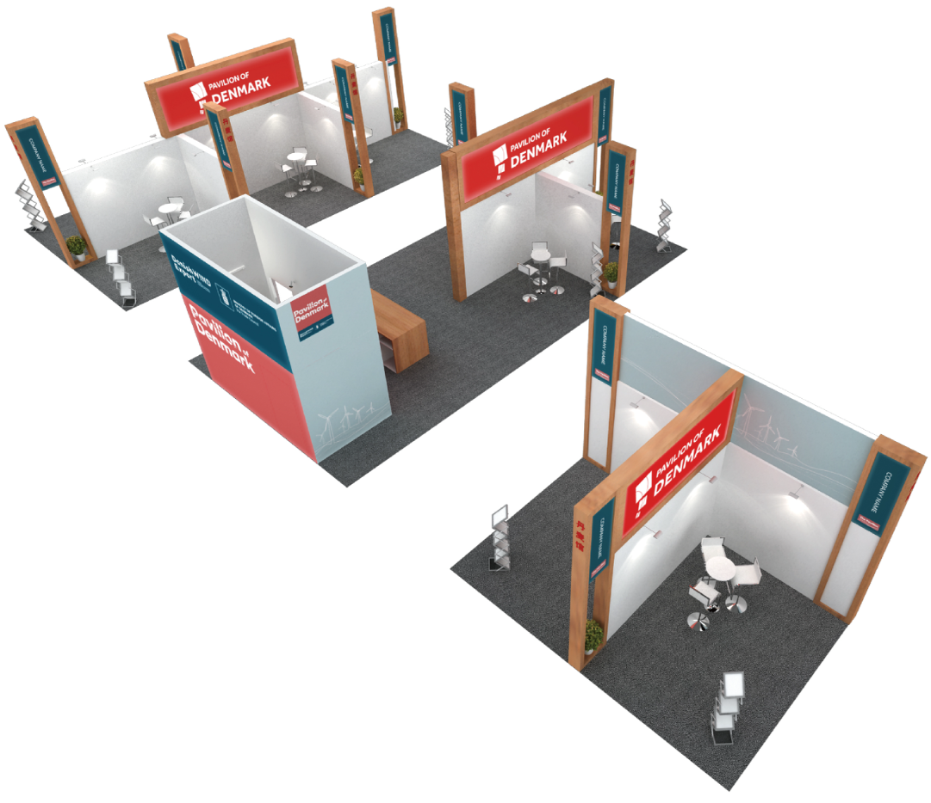
HANDLING OF YOUR GOODS
Standesign can help you handling your own equipment (unpacking and packing)
Must be ordered in advance via the order form
Please indicate the estimated hours and provide the following information:
Arrival of the goods
Amount of crates
Please note: We only empty the crates. We do not assemble your equipment.

Slide 8
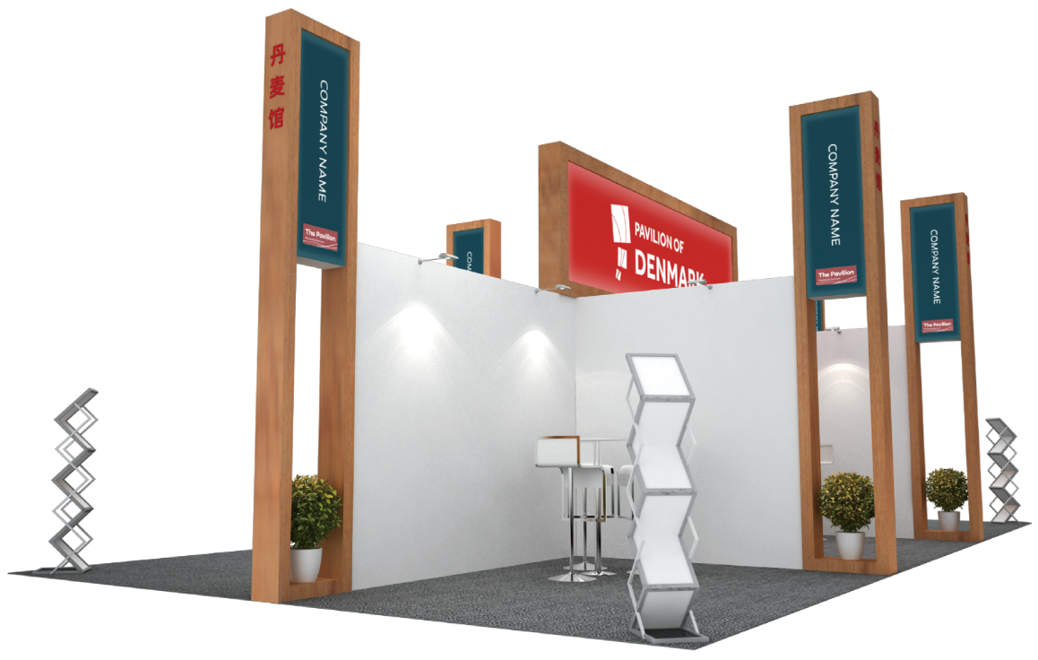
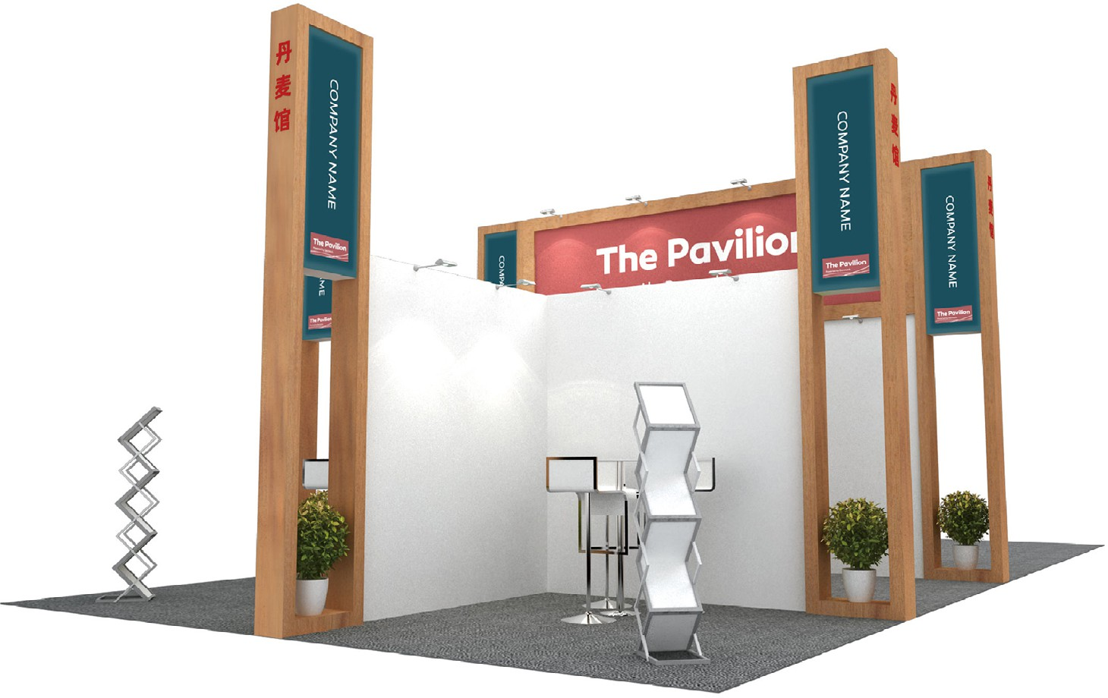
STAND HANDOVER
13th of October 2026 between 12.00 - 16.00 ( 12 noon – 4 pm )
Stands must be completed, and excess products and materials must be removed from all halls no later than
17.00 ( 5 pm ) on Tuesday 13th of October – please allow time to load and unload vehicles.
During build up and breakdown, contractors and exhibitors are required to wear build up/breakdown passes and Personal Protective Equipment at all times and to comply with the Health and Safety Regulations of the venue

Slide 9

THANK YOU FOR LISTENING
TOGETHER WE MAKE IT POSSIBLE

